Slide 1
CRUNCHY BITS
presents

Slide 2
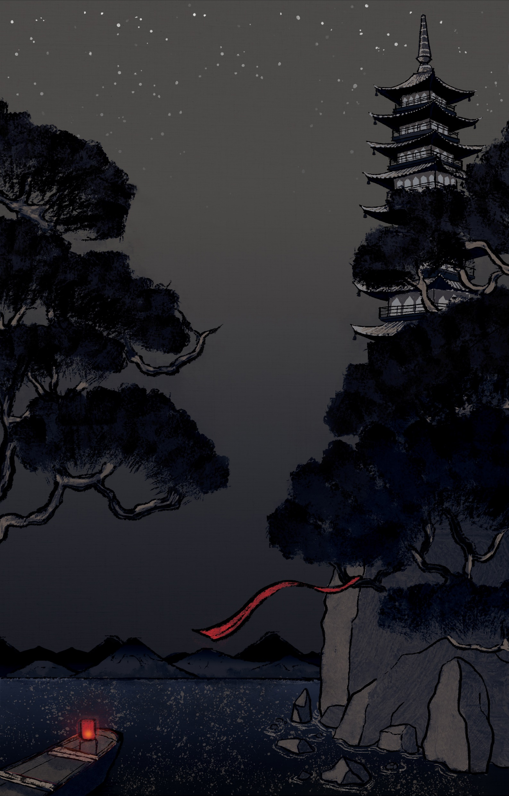


Slide 3
Project Goals
1: Concentrate on one simple mechanic but make it pop!
2: Polish it until it shines.

Slide 4
Scope
Must Have | Should Have | Nice to Have
Swiping Combat Mechanic ✔ | Particle Effects ✔ | Bosses CUT
Enemies x3 ✔ | Adaptive UI ✔ | Enemies x6 ✔
Player Character ✔ | Overworld ✔ | Level x3 ✔
Animations ✔ | Score ✔ | Achievements CUT
Level x1 ✔ | Stylized 3D Environments ✔ | Unlockables (Skins) CUT
SFX ✔ | Traditional Instrumentation ✔
 | Unique Monster Sounds ✔

Slide 5
DEVLOG

Slide 6
Ole Ortmann
Uses Pepsi as mouthwash

Slide 7
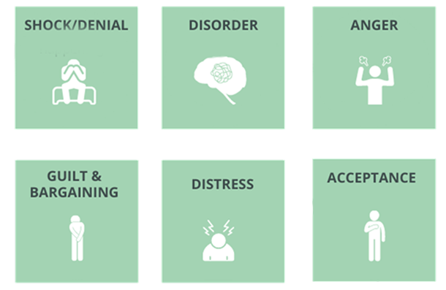
6 stages of grief mobile game development

Slide 8
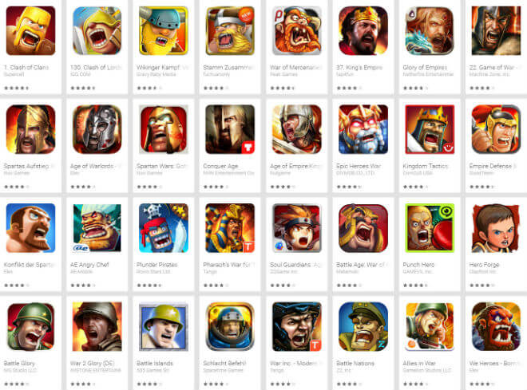
Shock/Denial

Slide 9
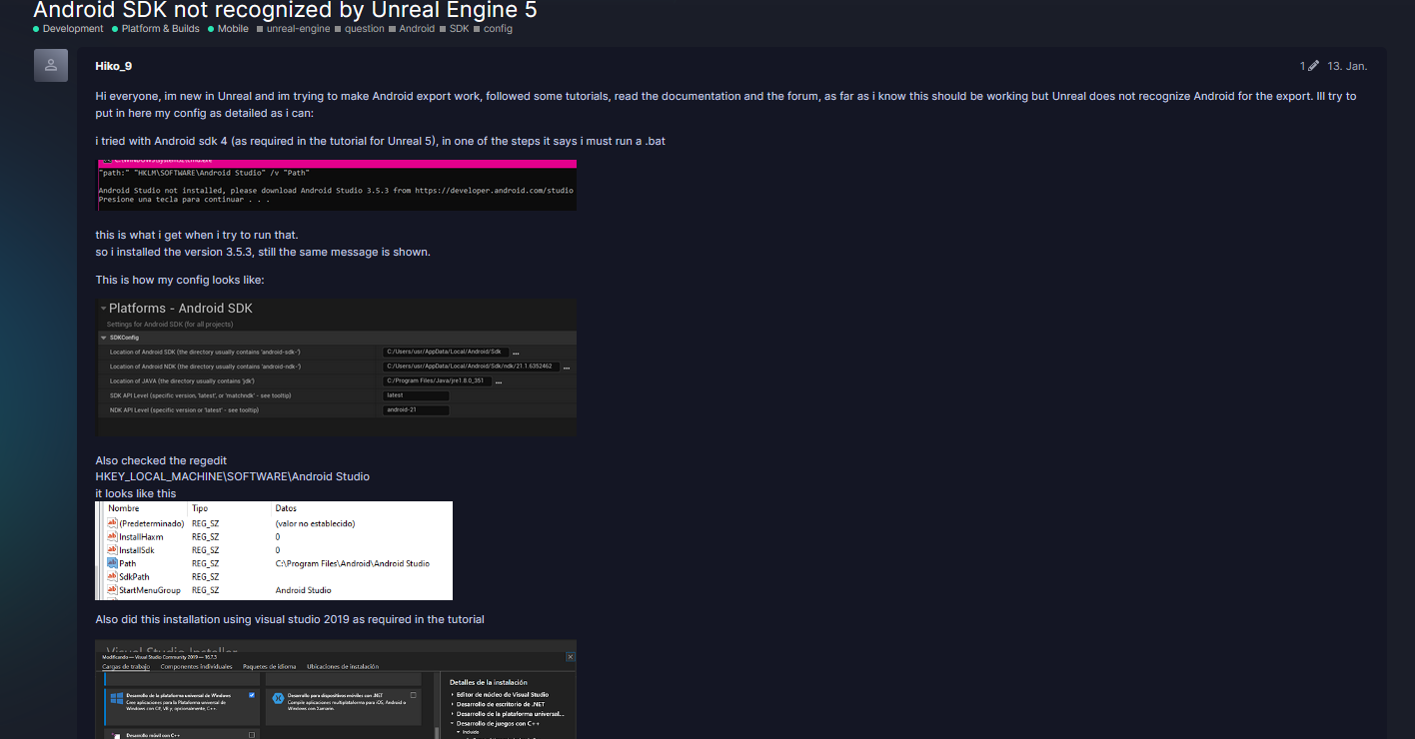
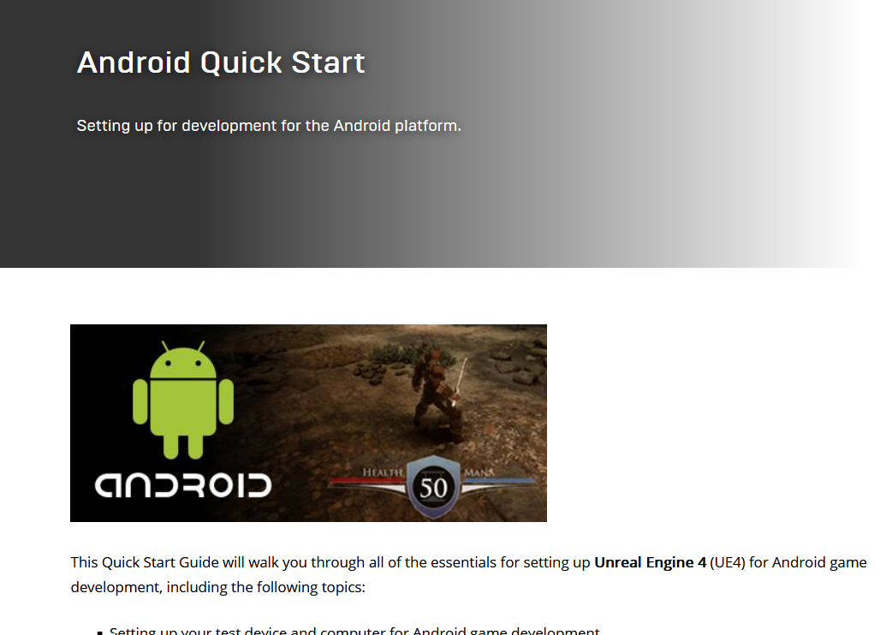
Disorder

Slide 10
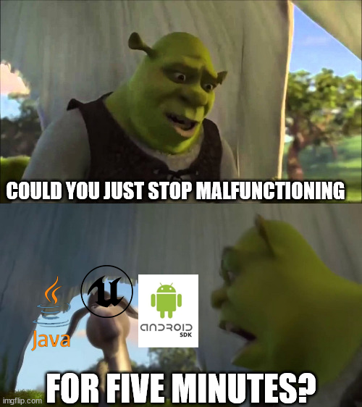
Guilt/Bargaining

Slide 11
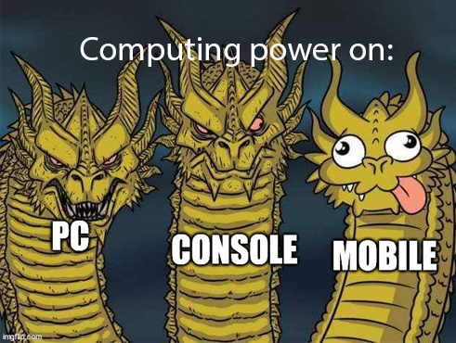
Distress

Slide 12
Acceptance
Good Game
(But never again)

Slide 13
Zhu Zhaoliang
Likes chicken teriyaki

Slide 14




In-game Music
INSTRUMENTATION
MELODIC
RHYTHM
TEXTURE

Slide 15
In-game SFX
Inspiration
Idea

Slide 16
Waiyaki Otieno
Totally not toxic

Slide 17
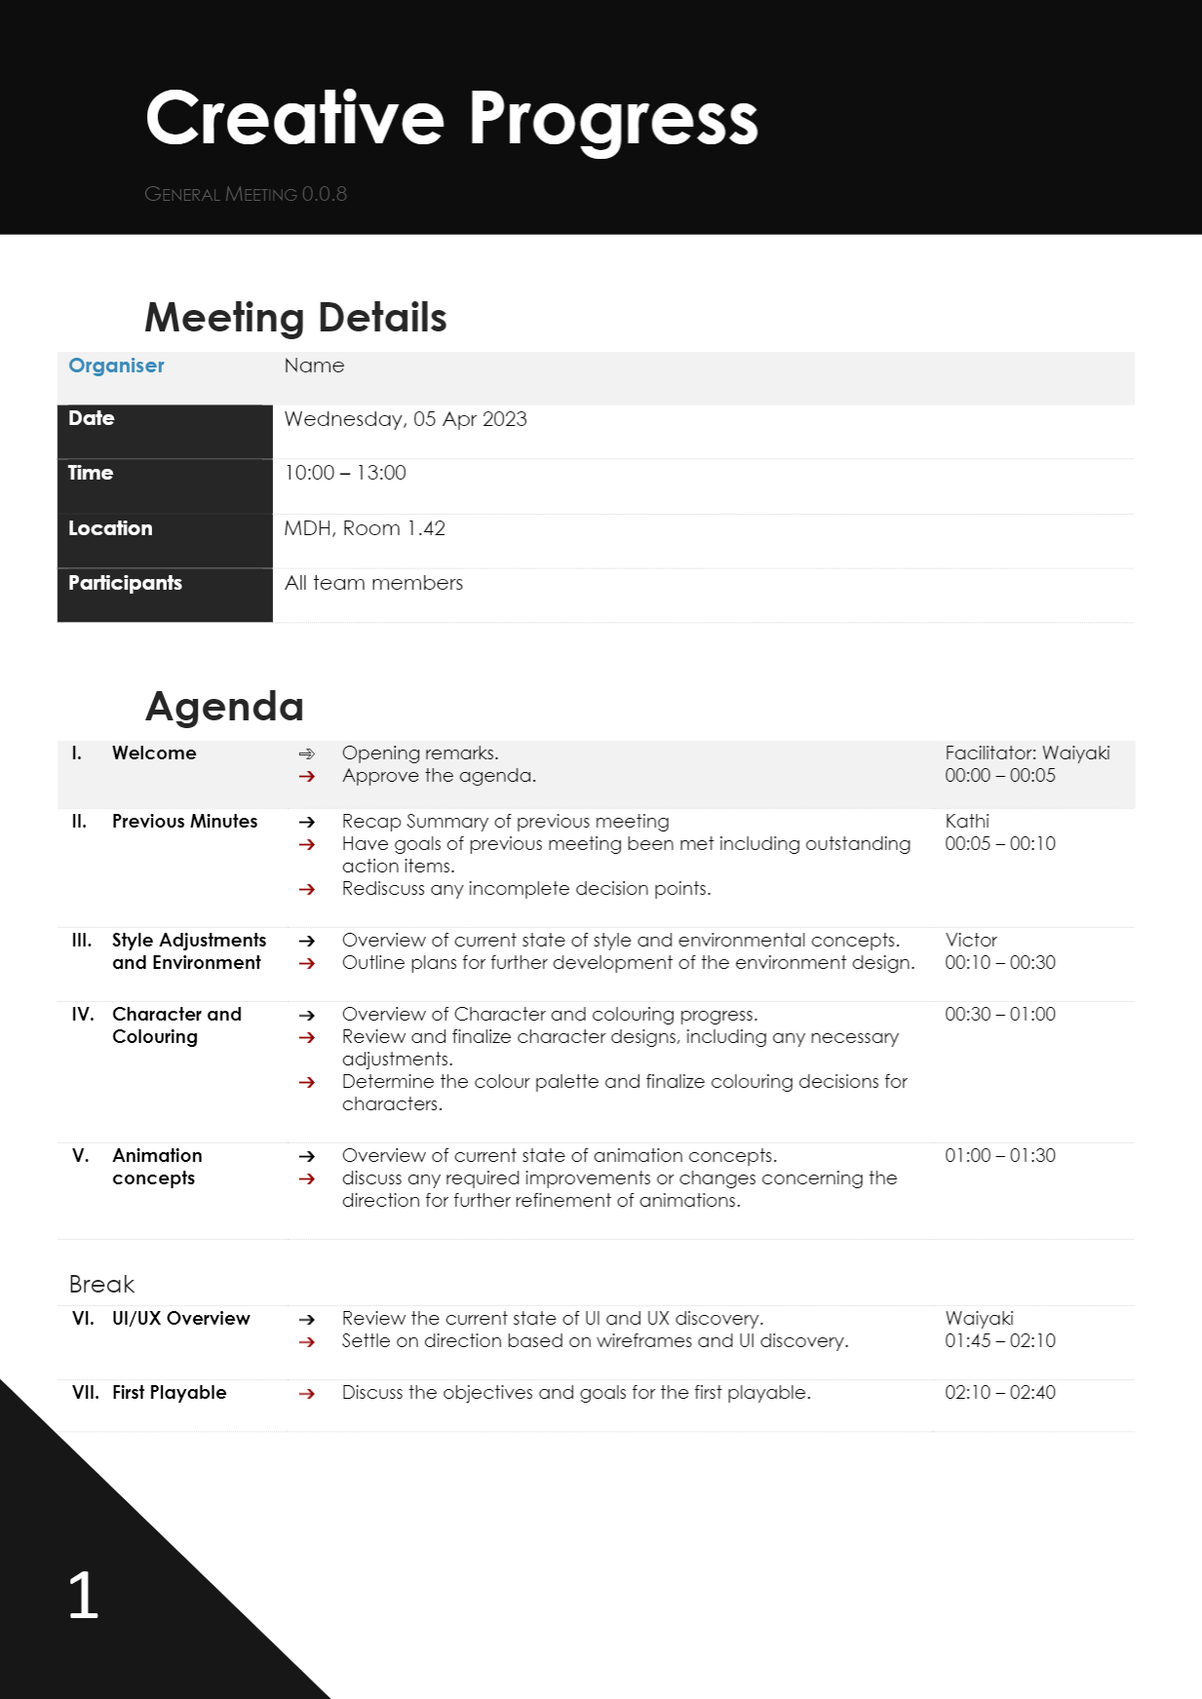
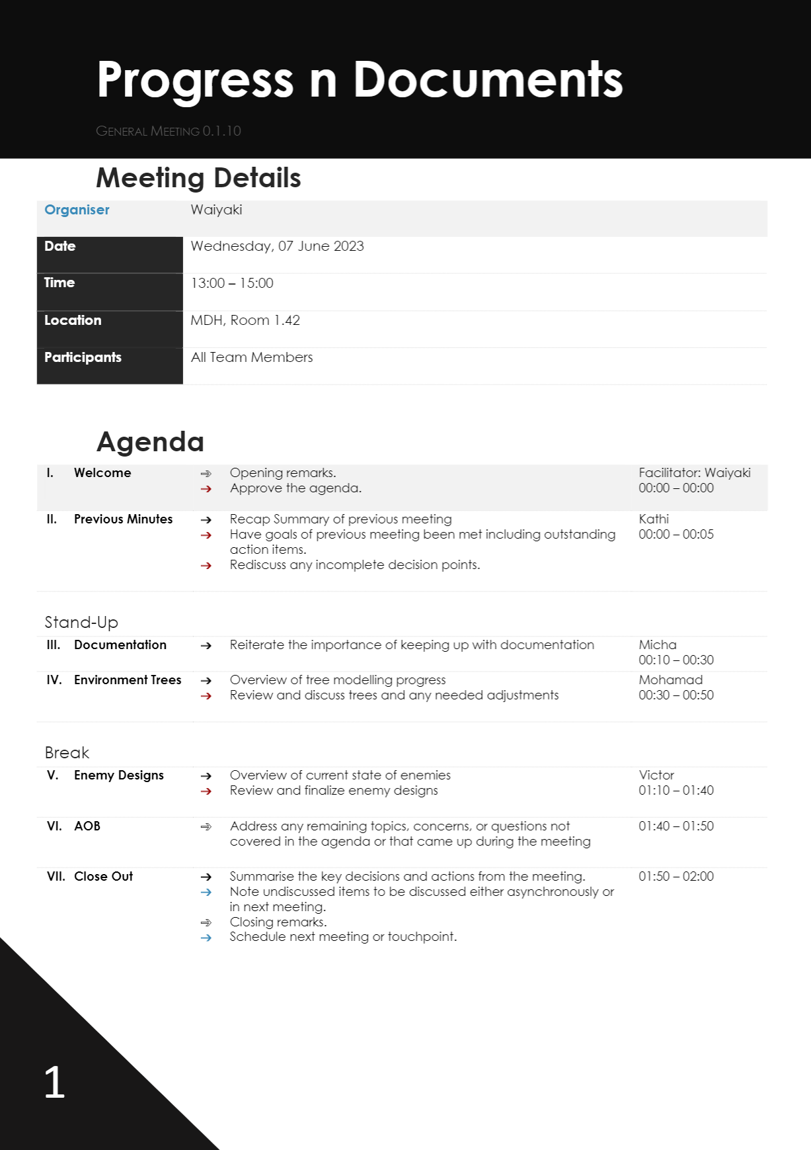
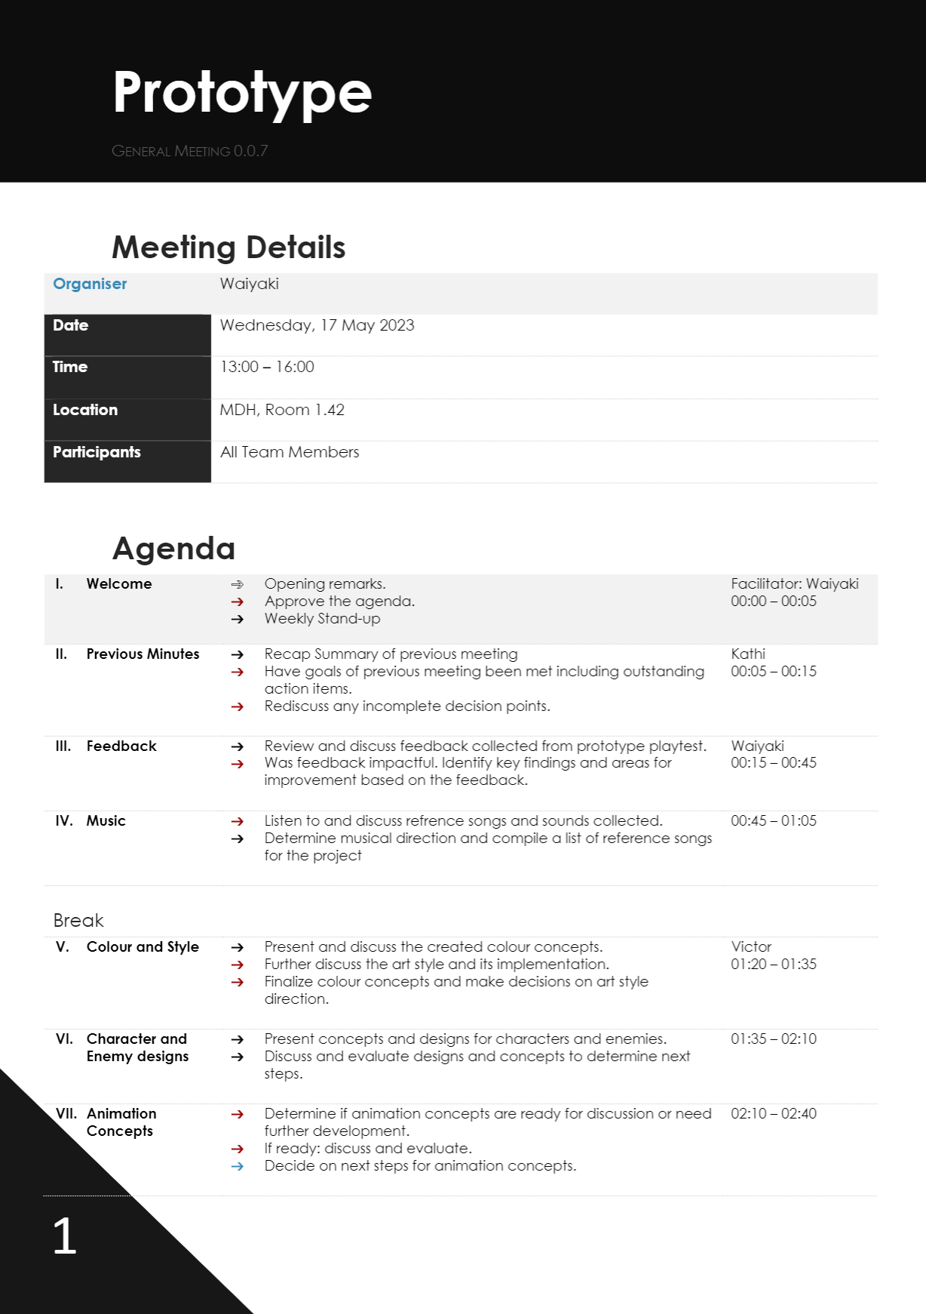
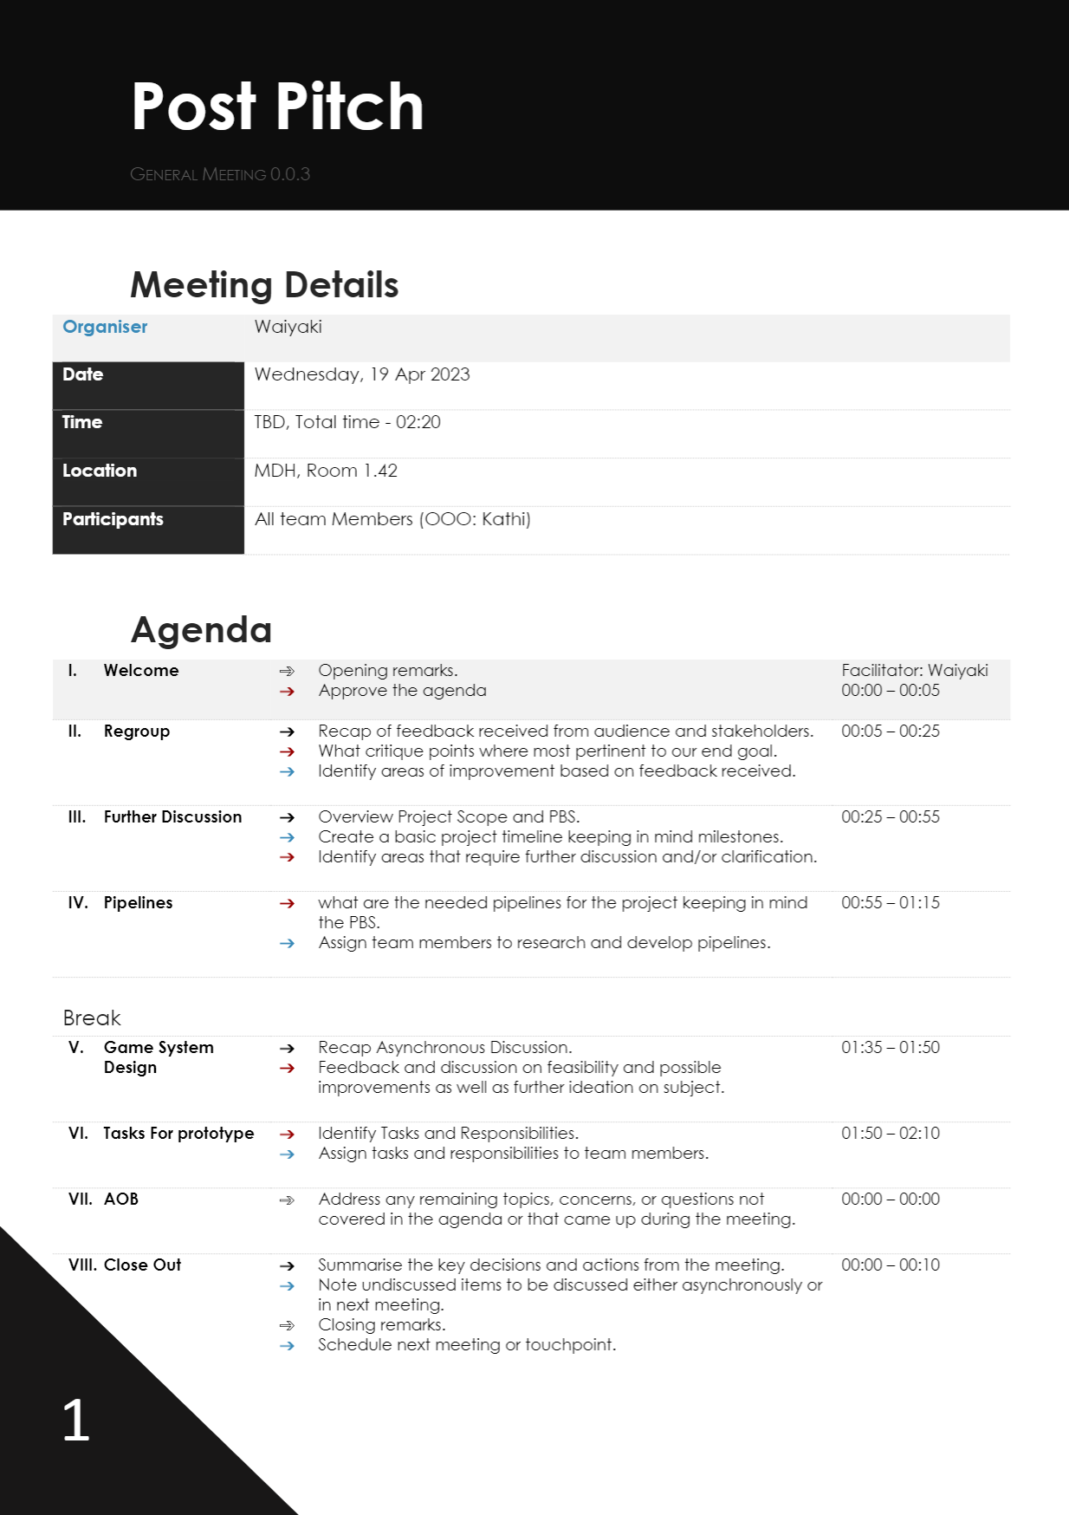
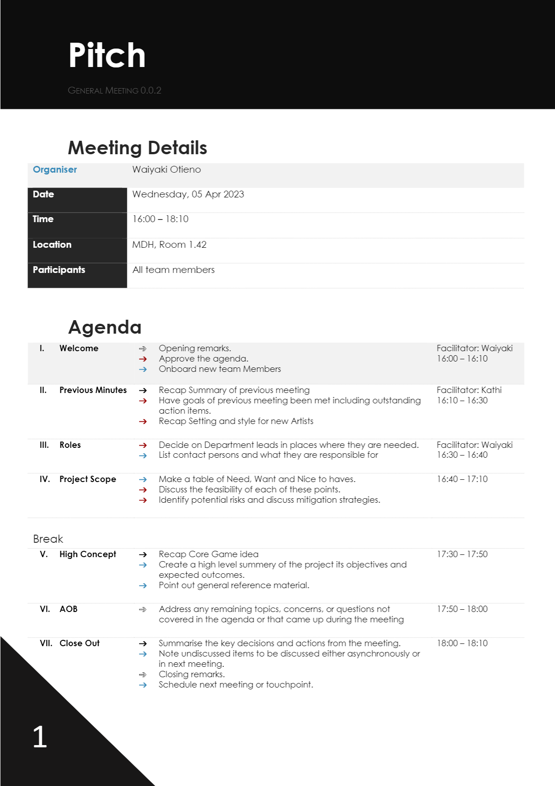
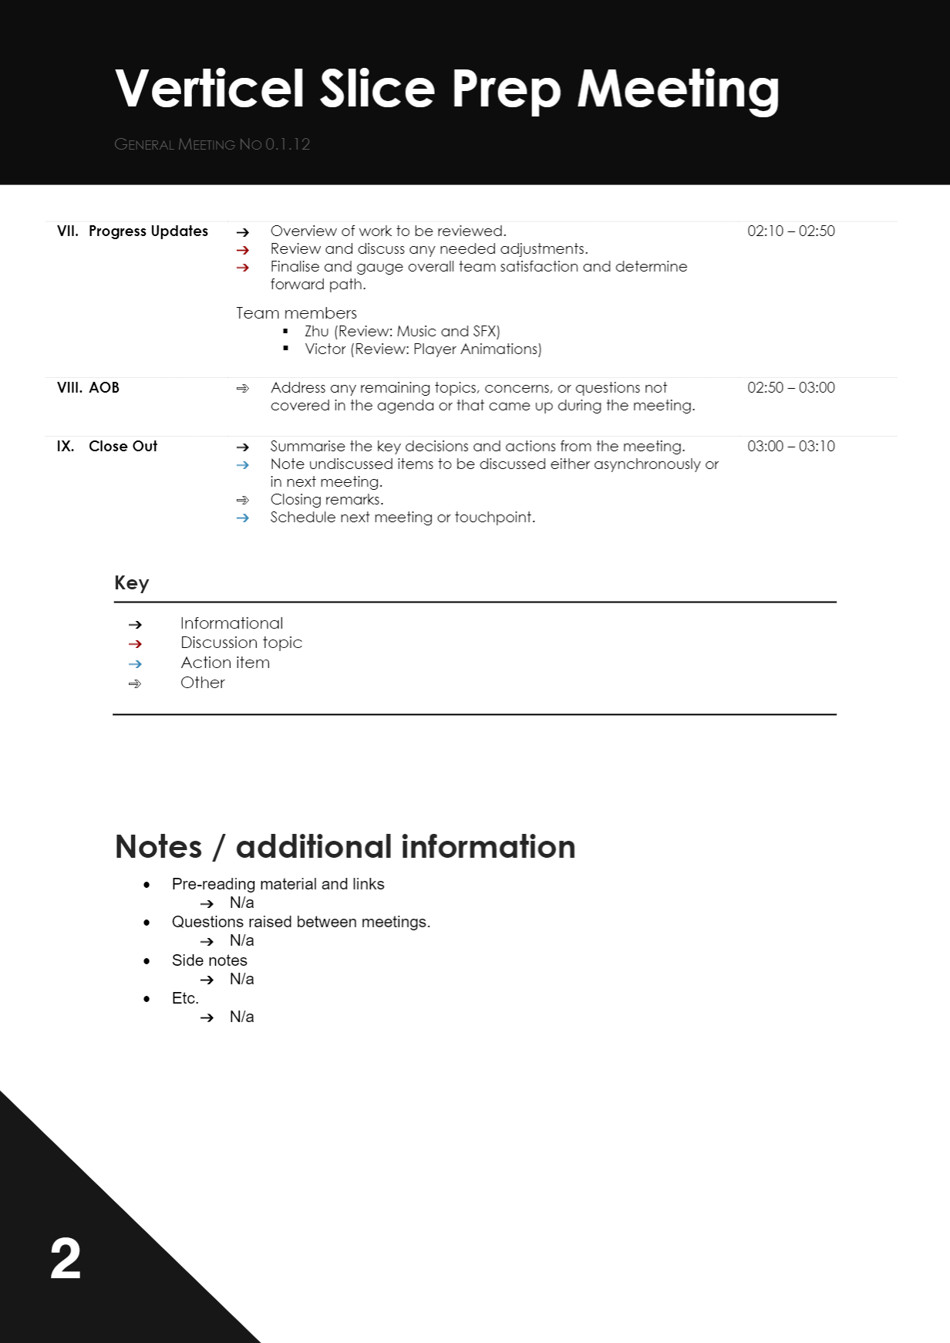
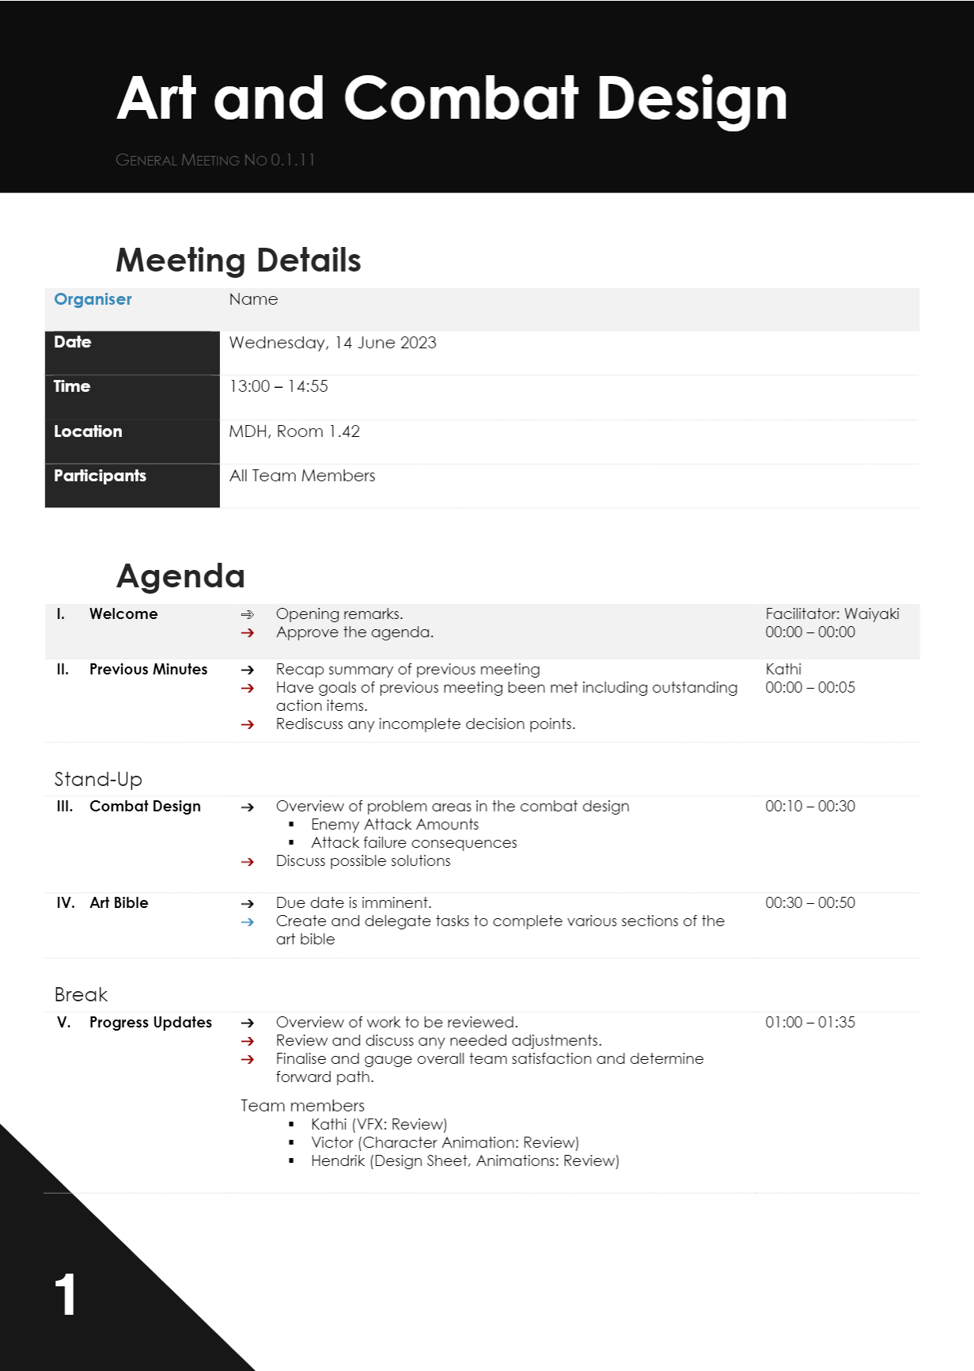
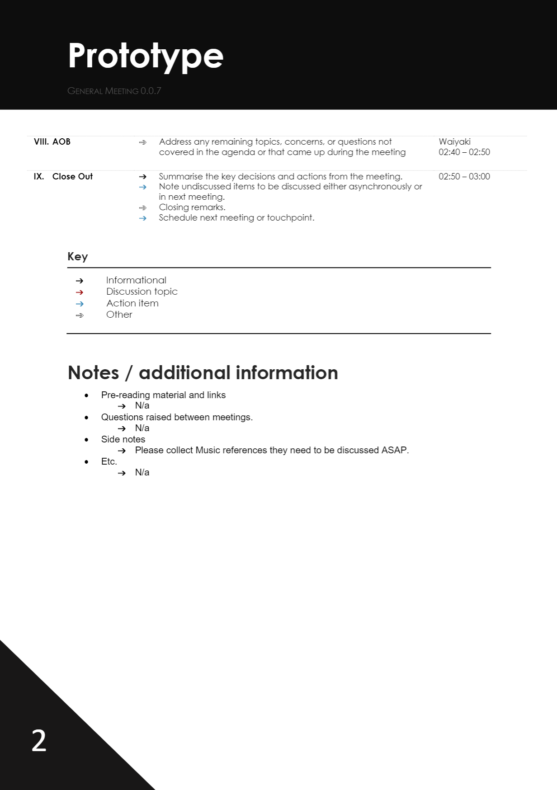

All the meetings

Slide 18
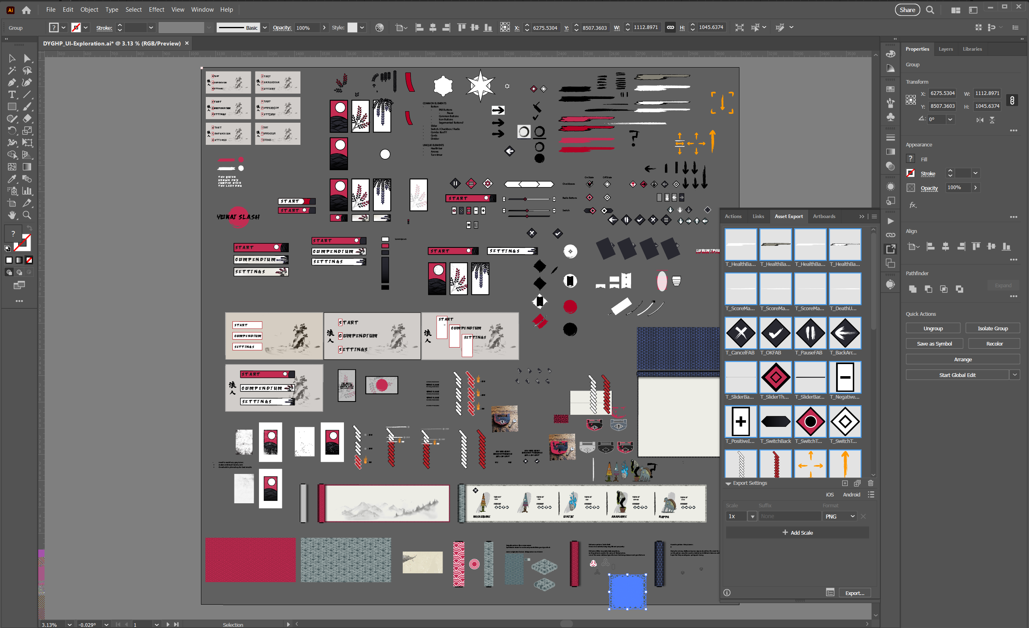
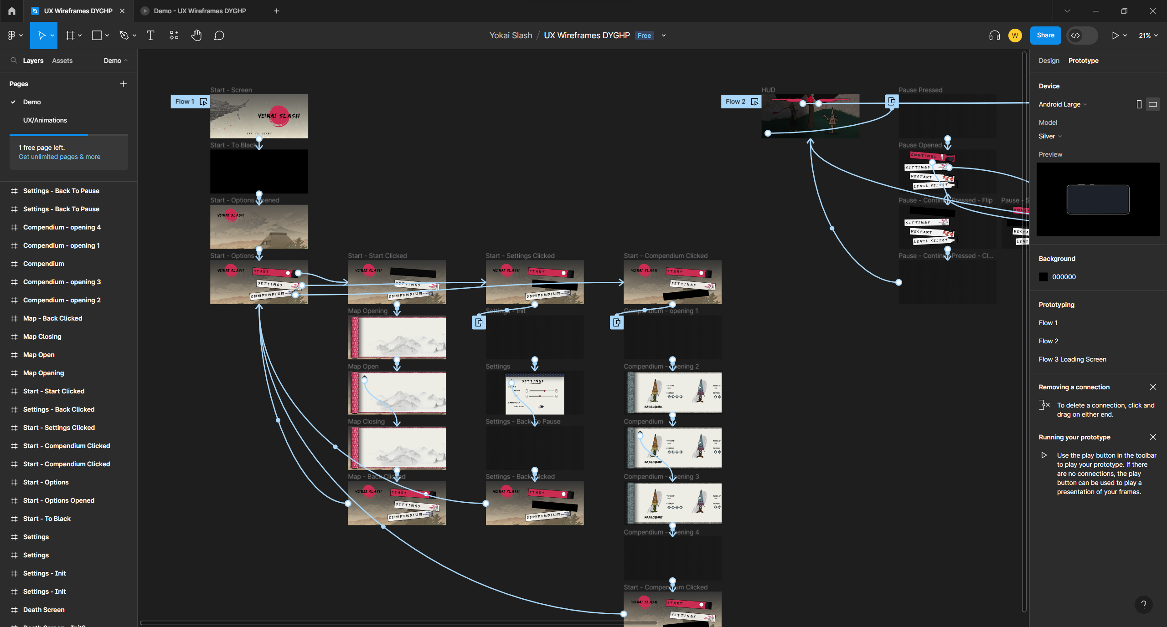
UX & UI

Slide 19
Michael Wick
Put proper pants on just for this occasion

Slide 20
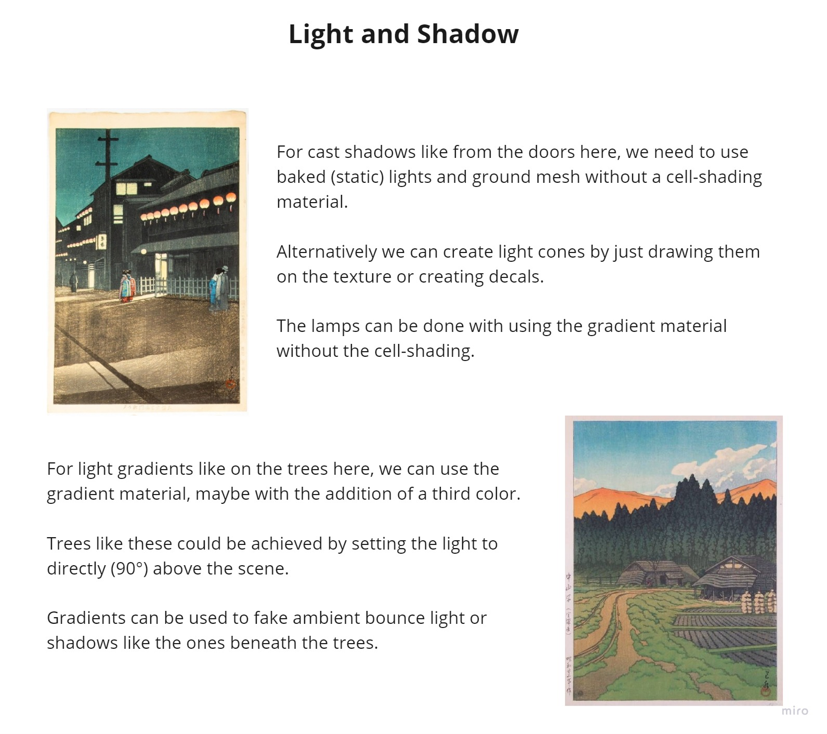
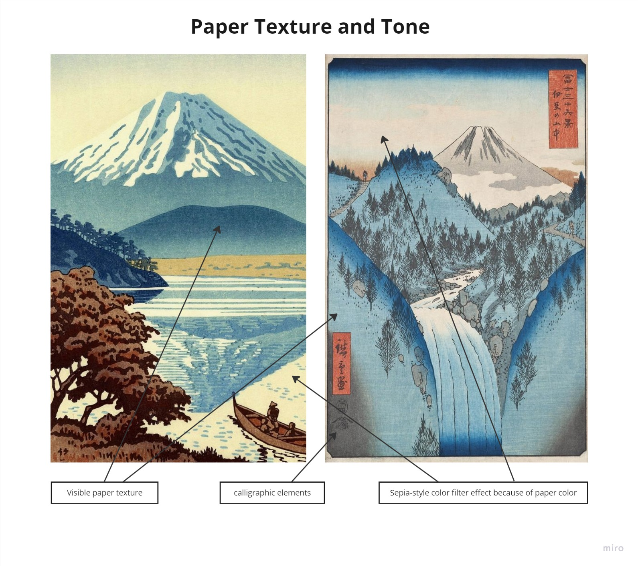
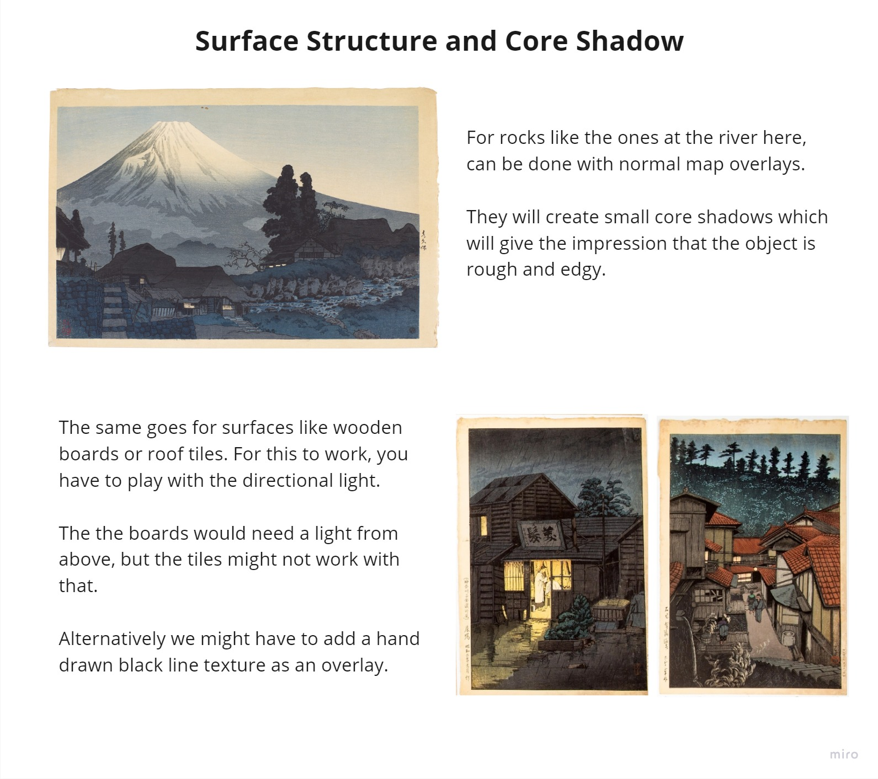
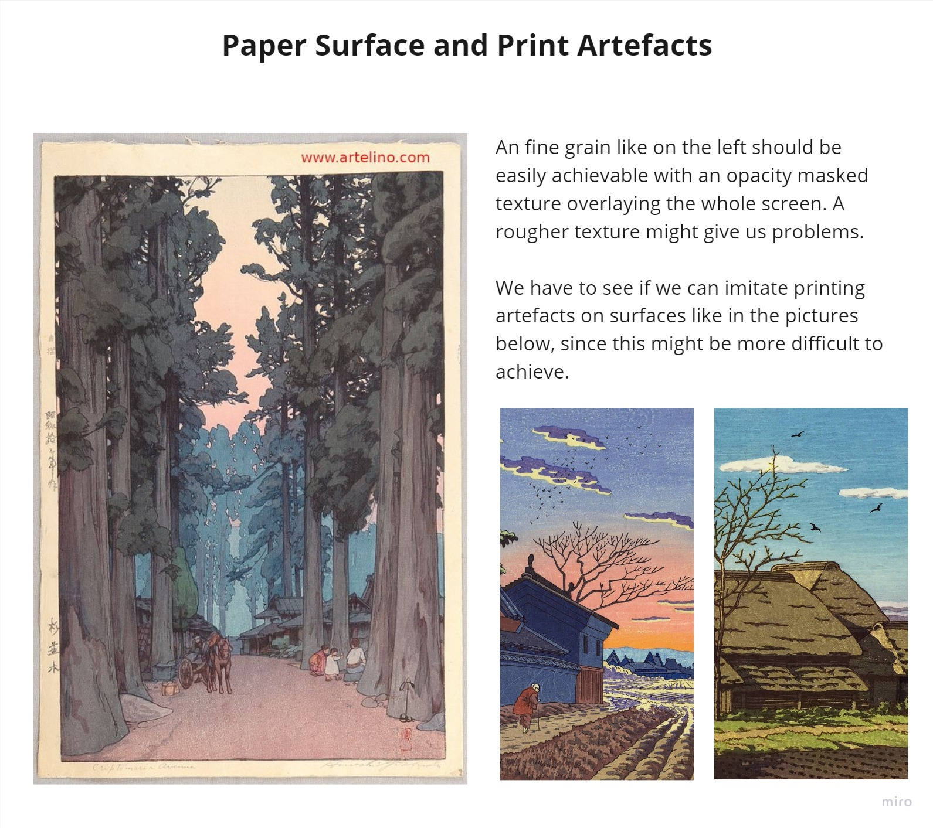
Environment Design

Slide 21

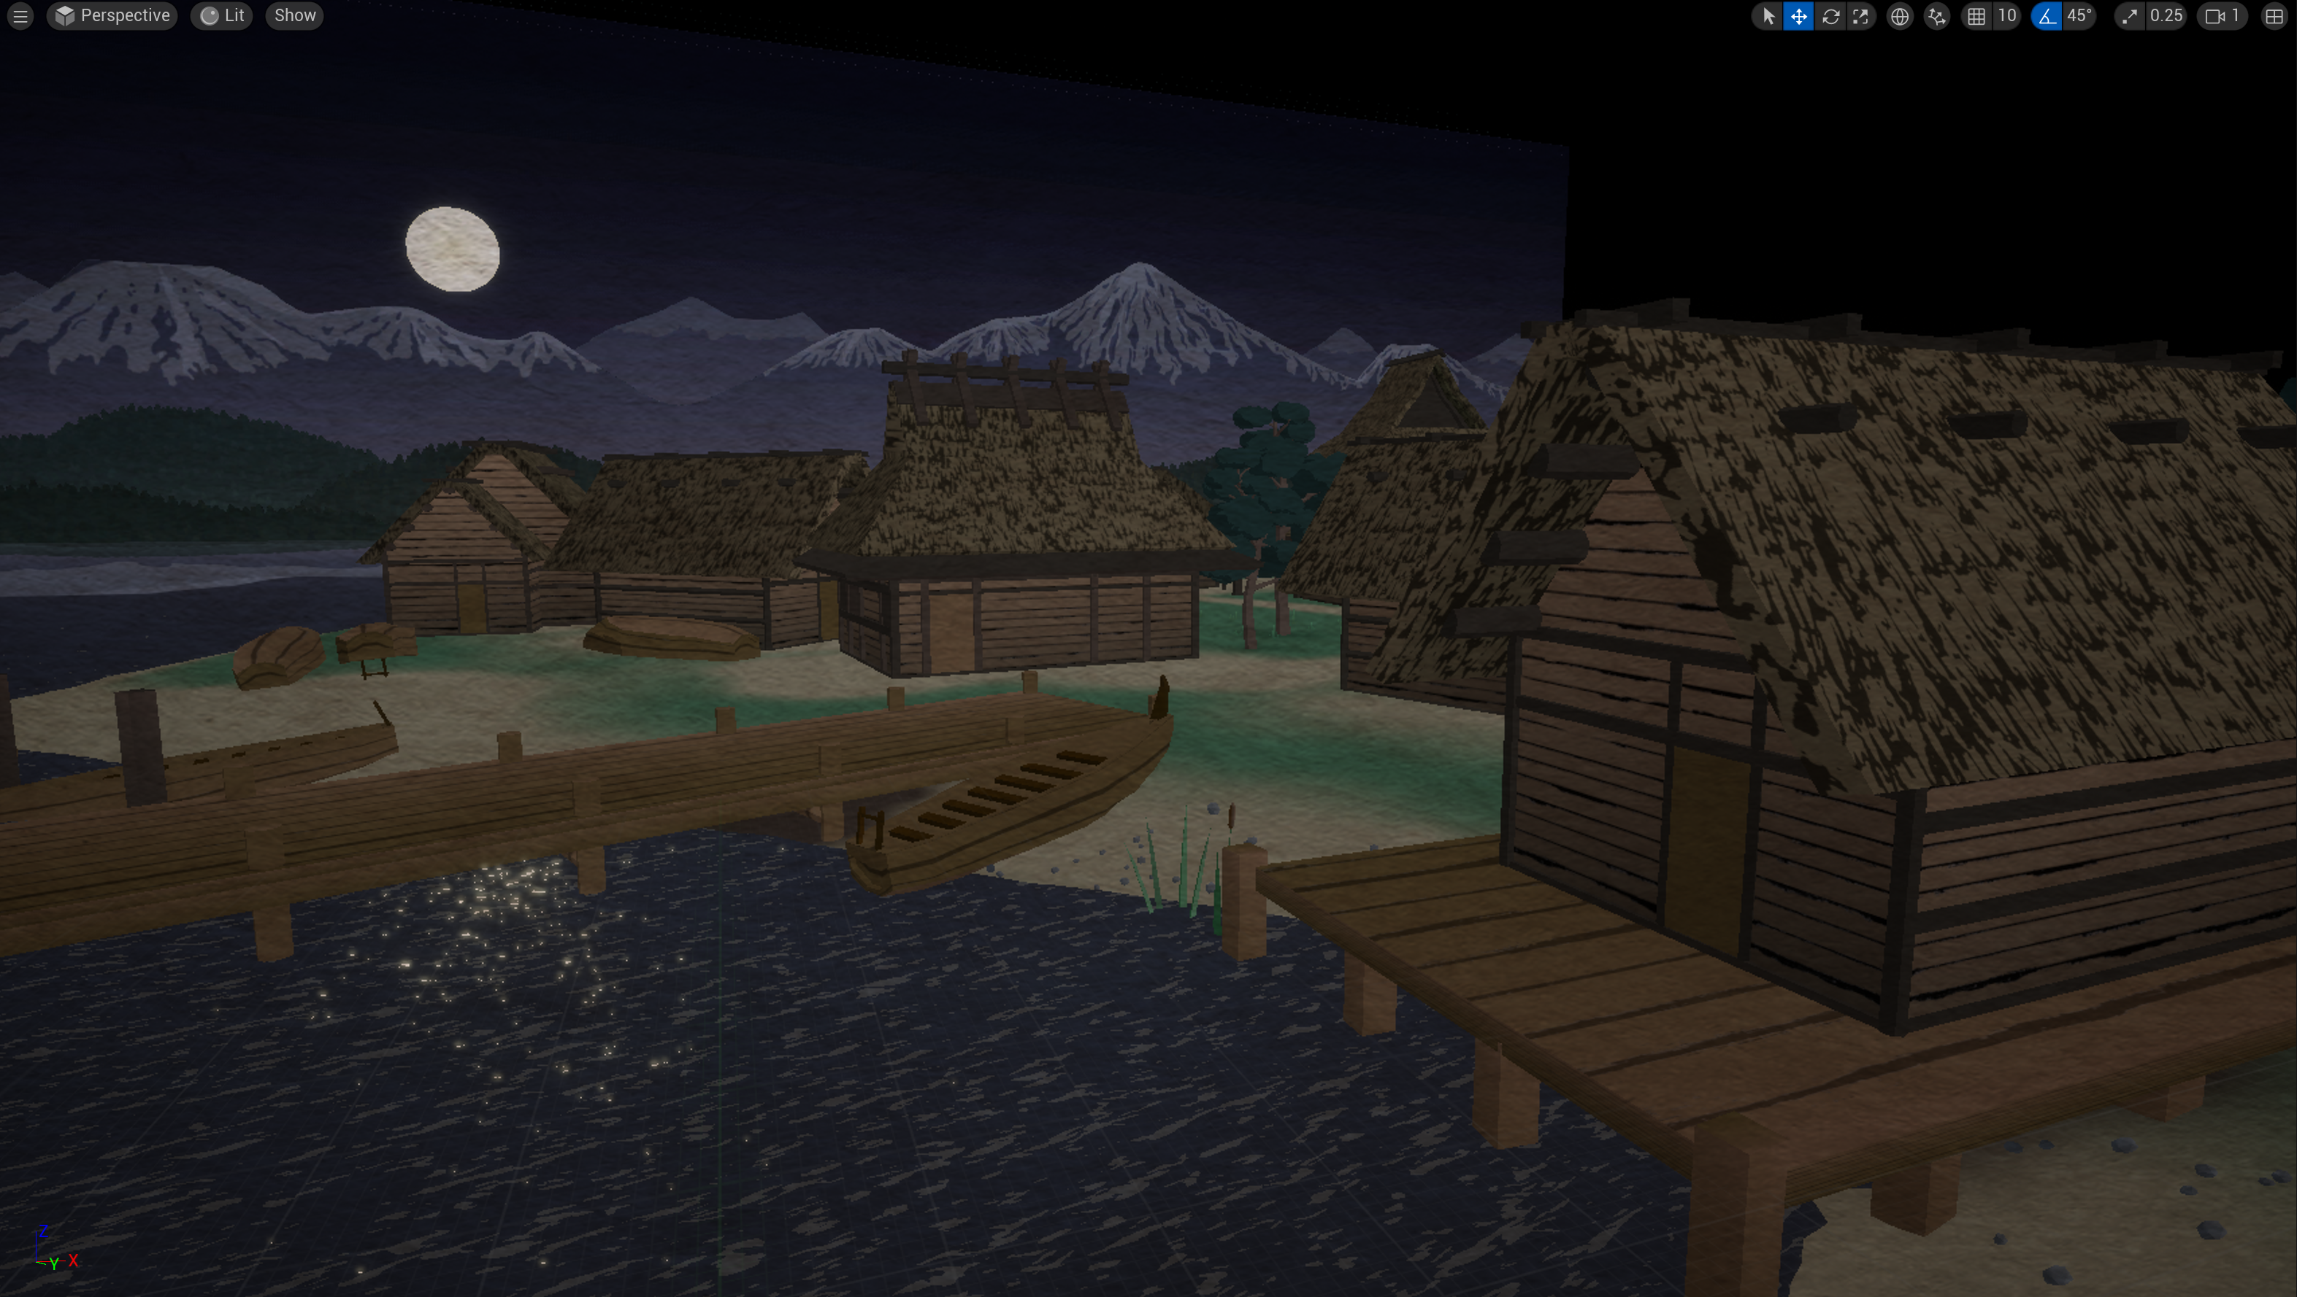
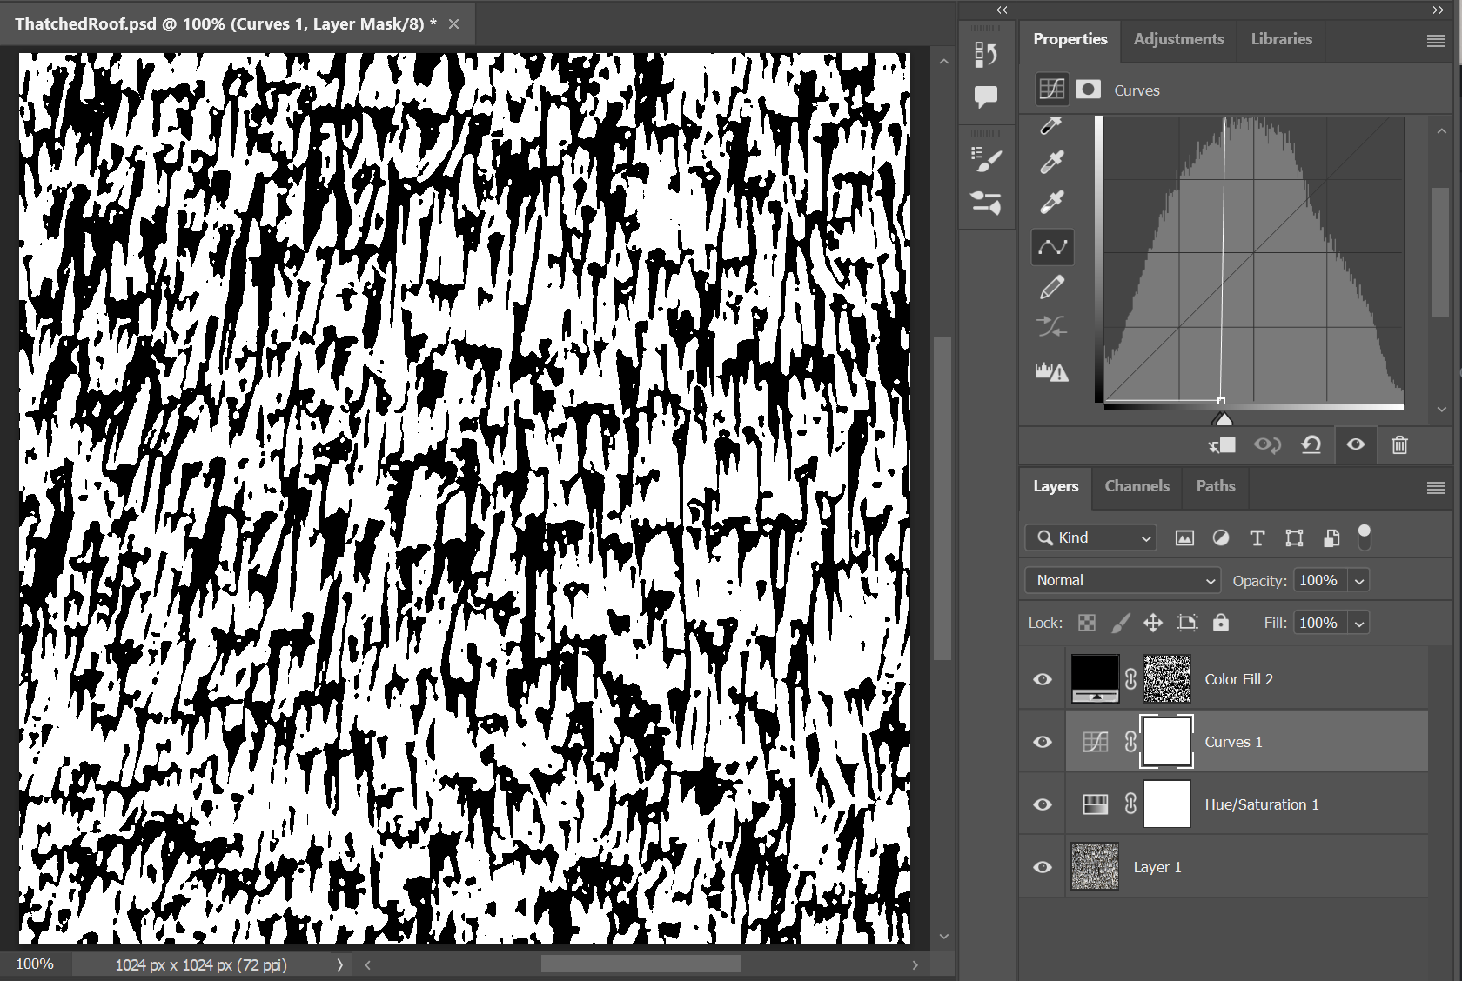
Environment Design

Slide 22
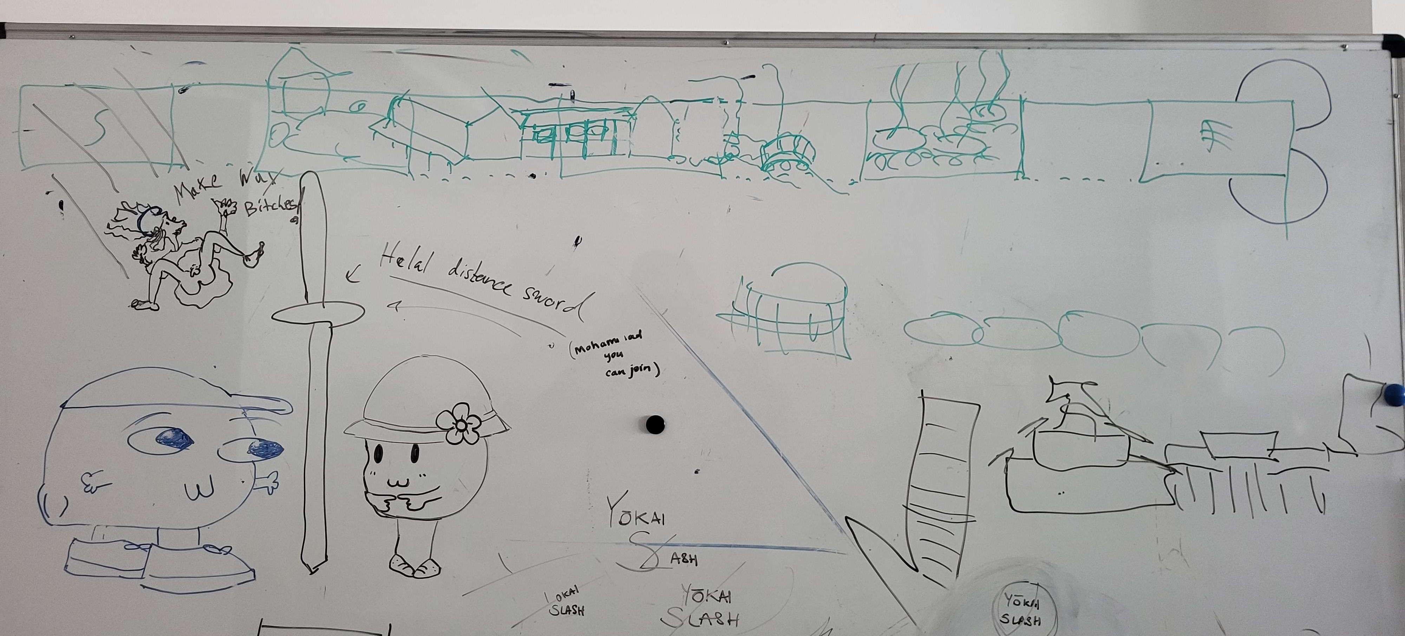
Environment Design

Slide 23







Environment Design

Slide 24
Katharina Bornemann
“You can choose my subtitle”

Slide 25
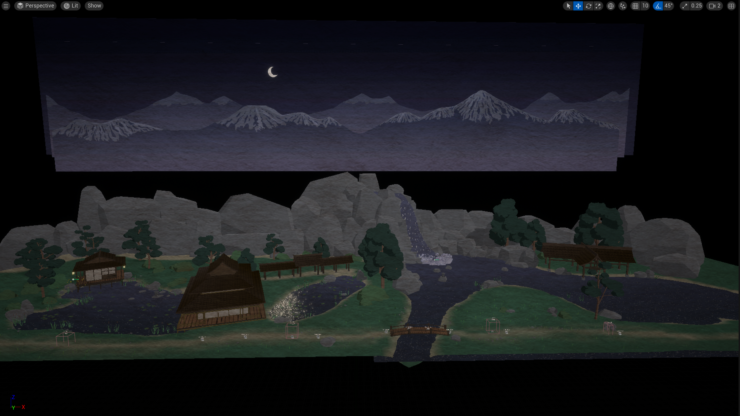
The Haunted Mansion

Slide 26
Mohamad Sharkawi
(Not a terrorist)

Slide 27
Victor Hübner
Just one more frame…

Slide 28

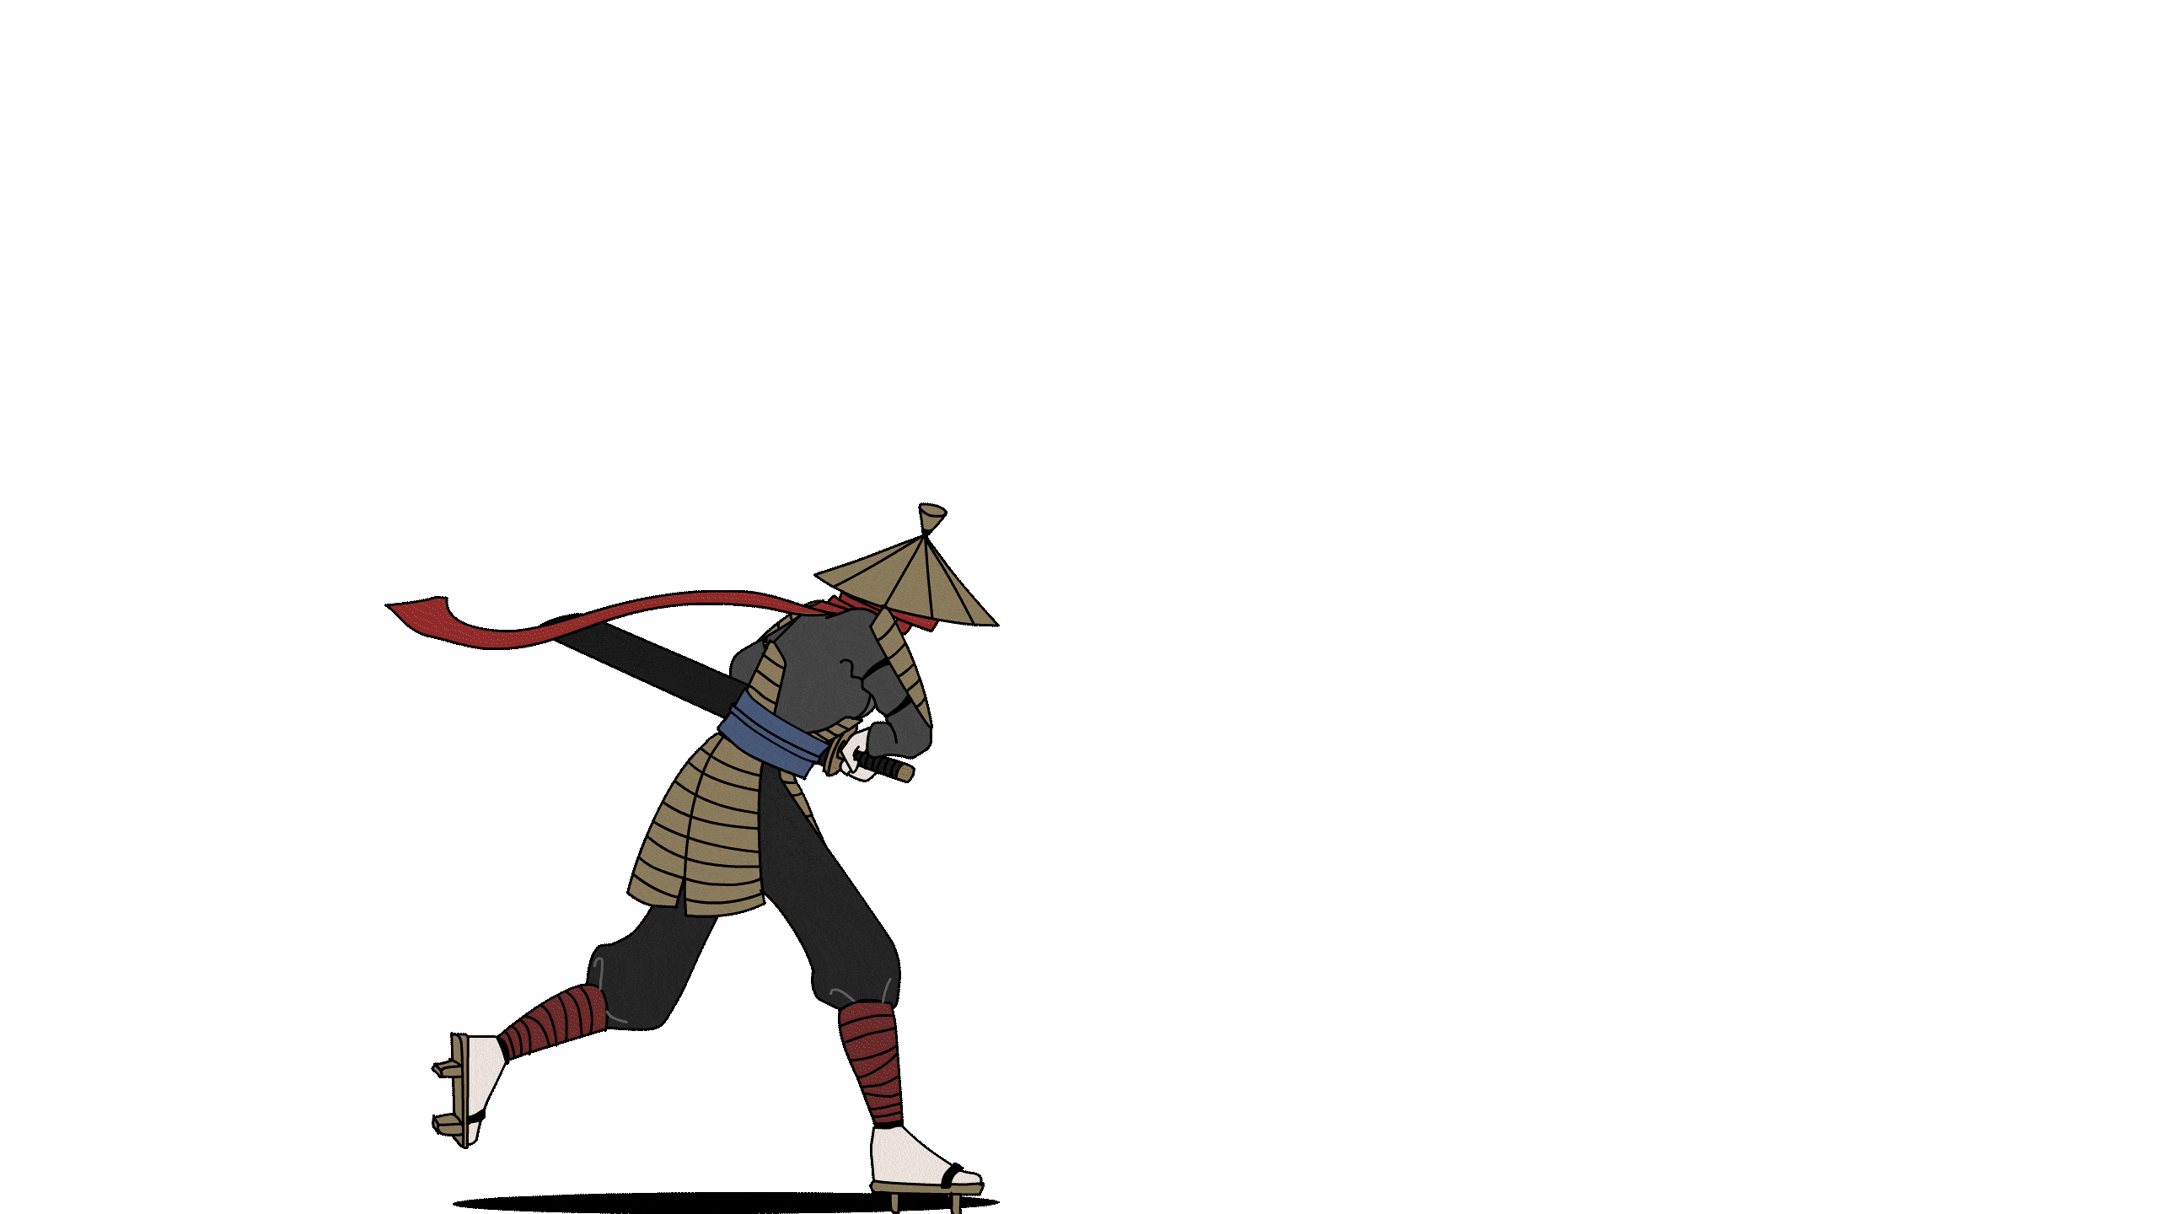




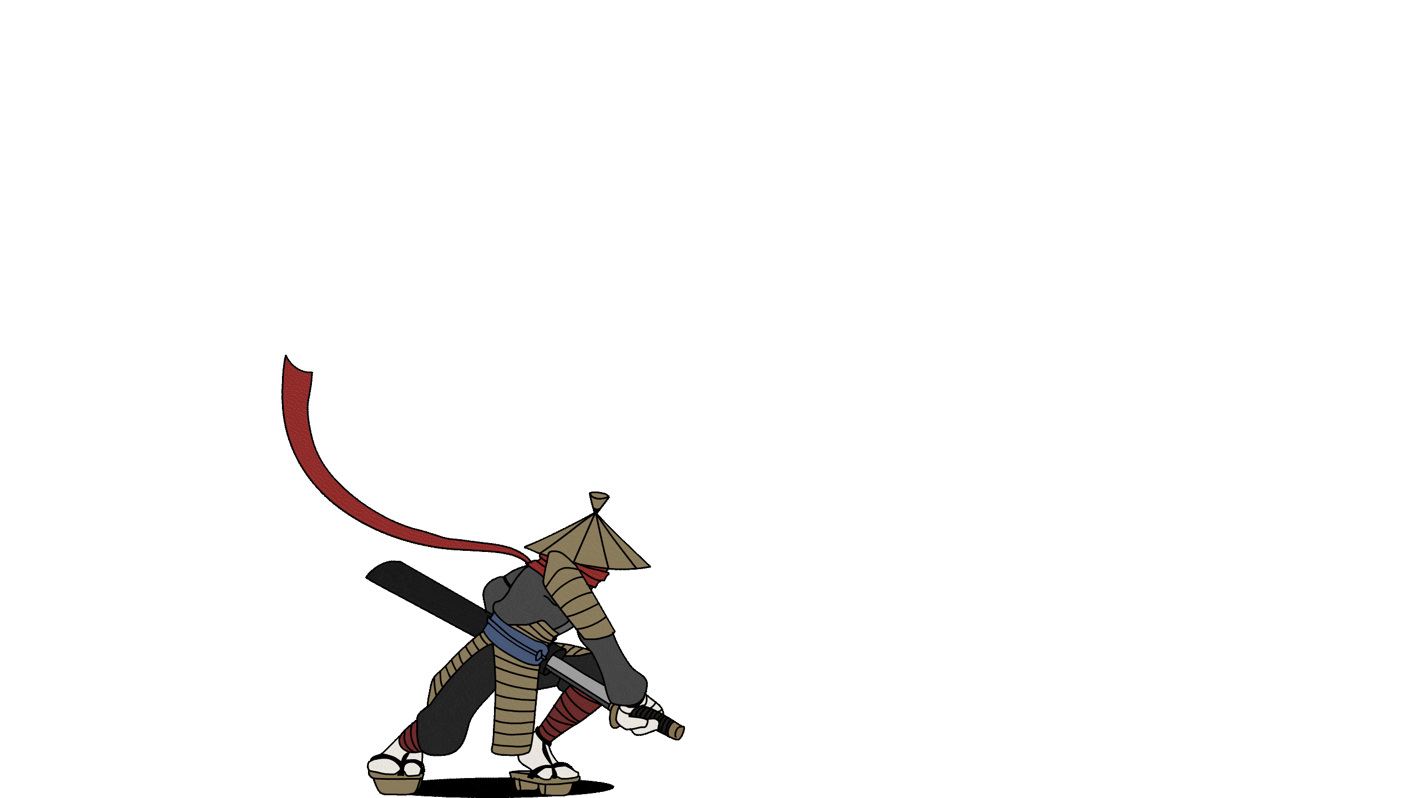





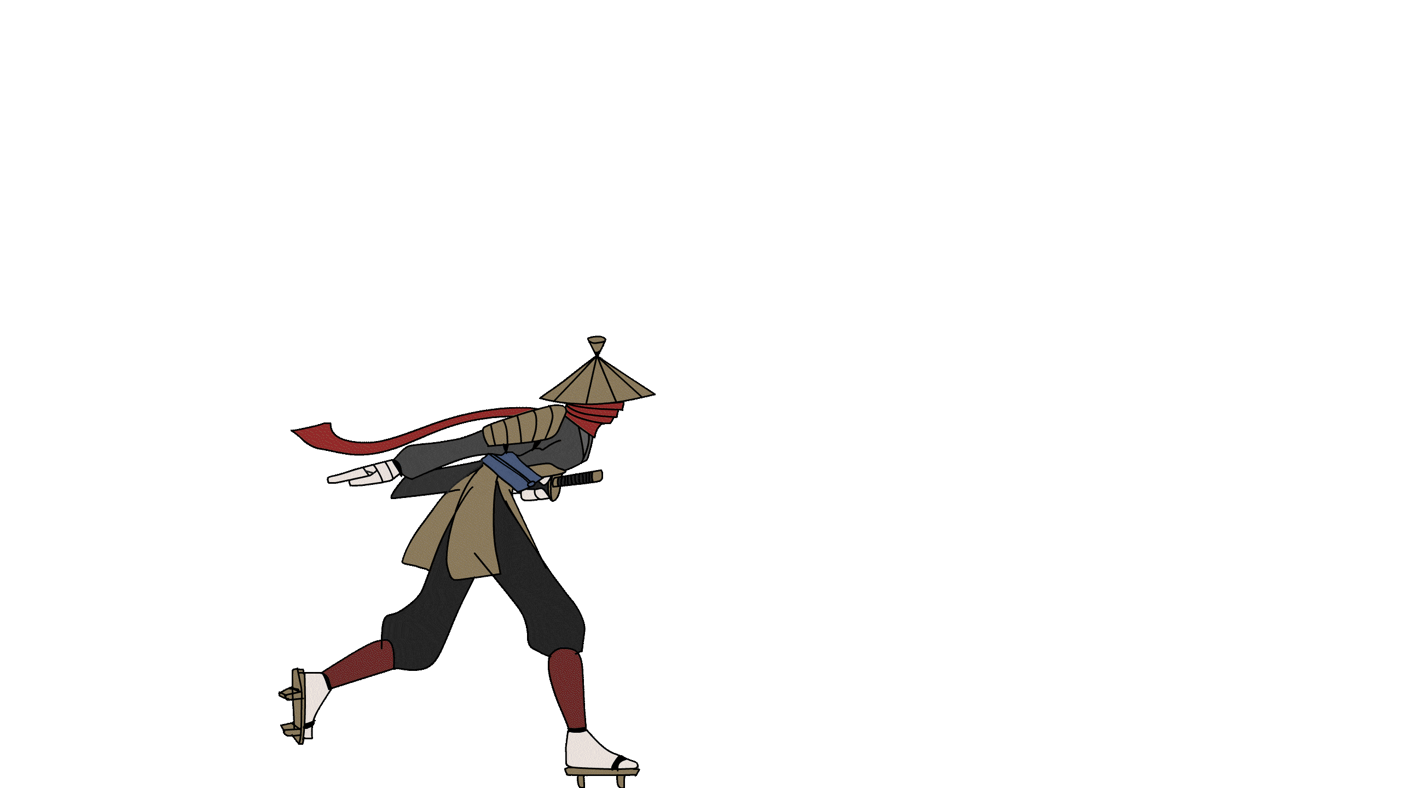
So many animations…

Slide 29
Angeli Fernando
This is the seventh iteration of this subtitle because Victor said the previous ones all had a style clash problem

Slide 30
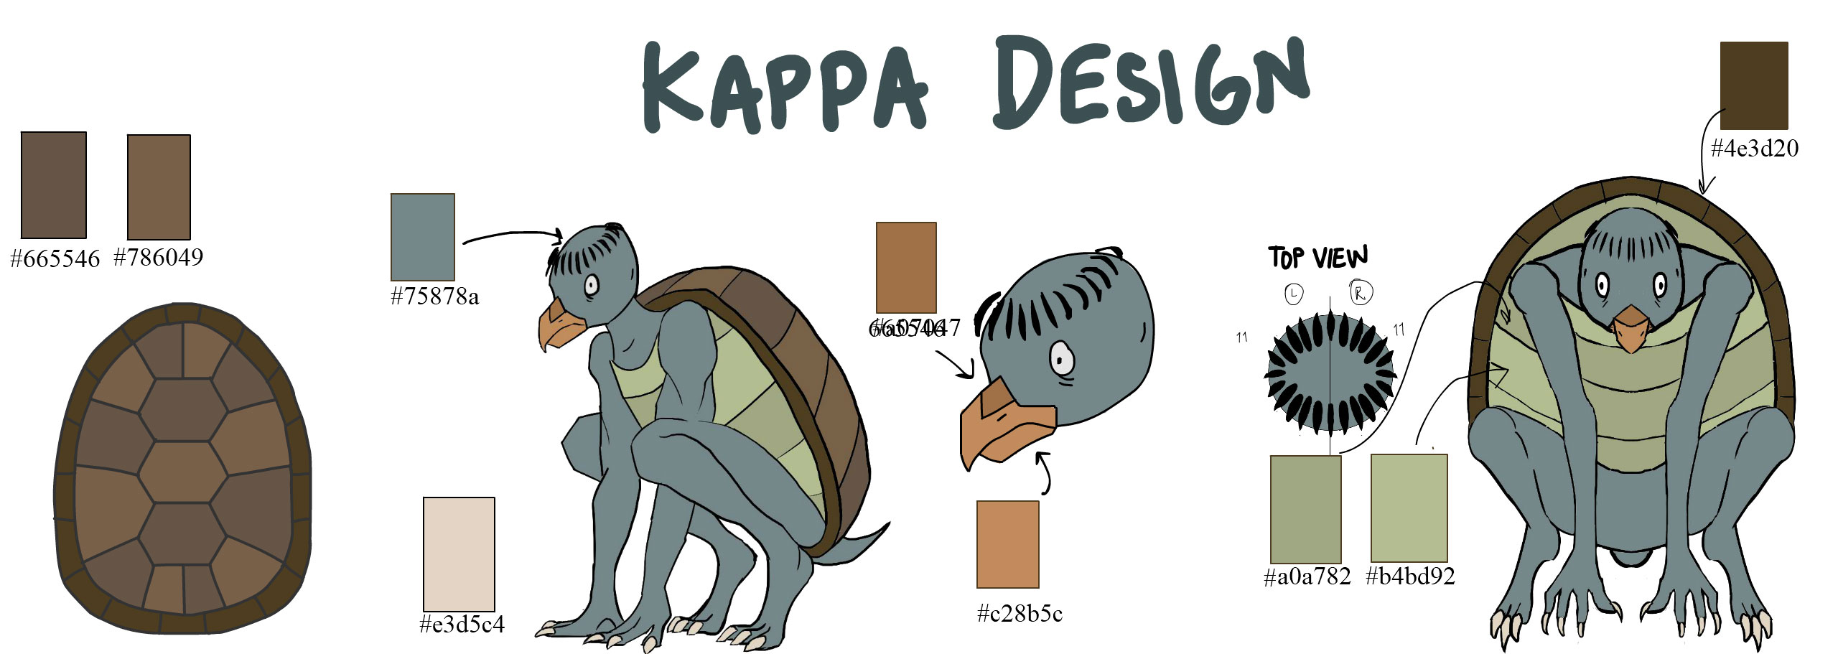
The Kappa

Slide 31
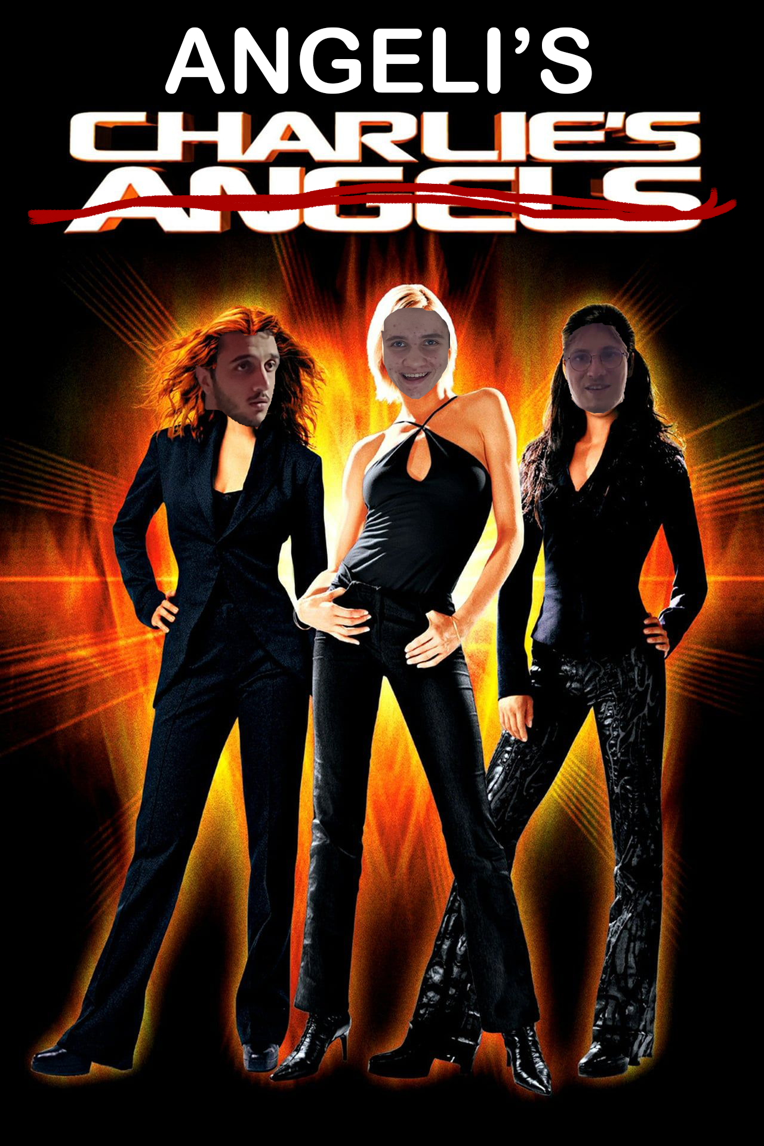
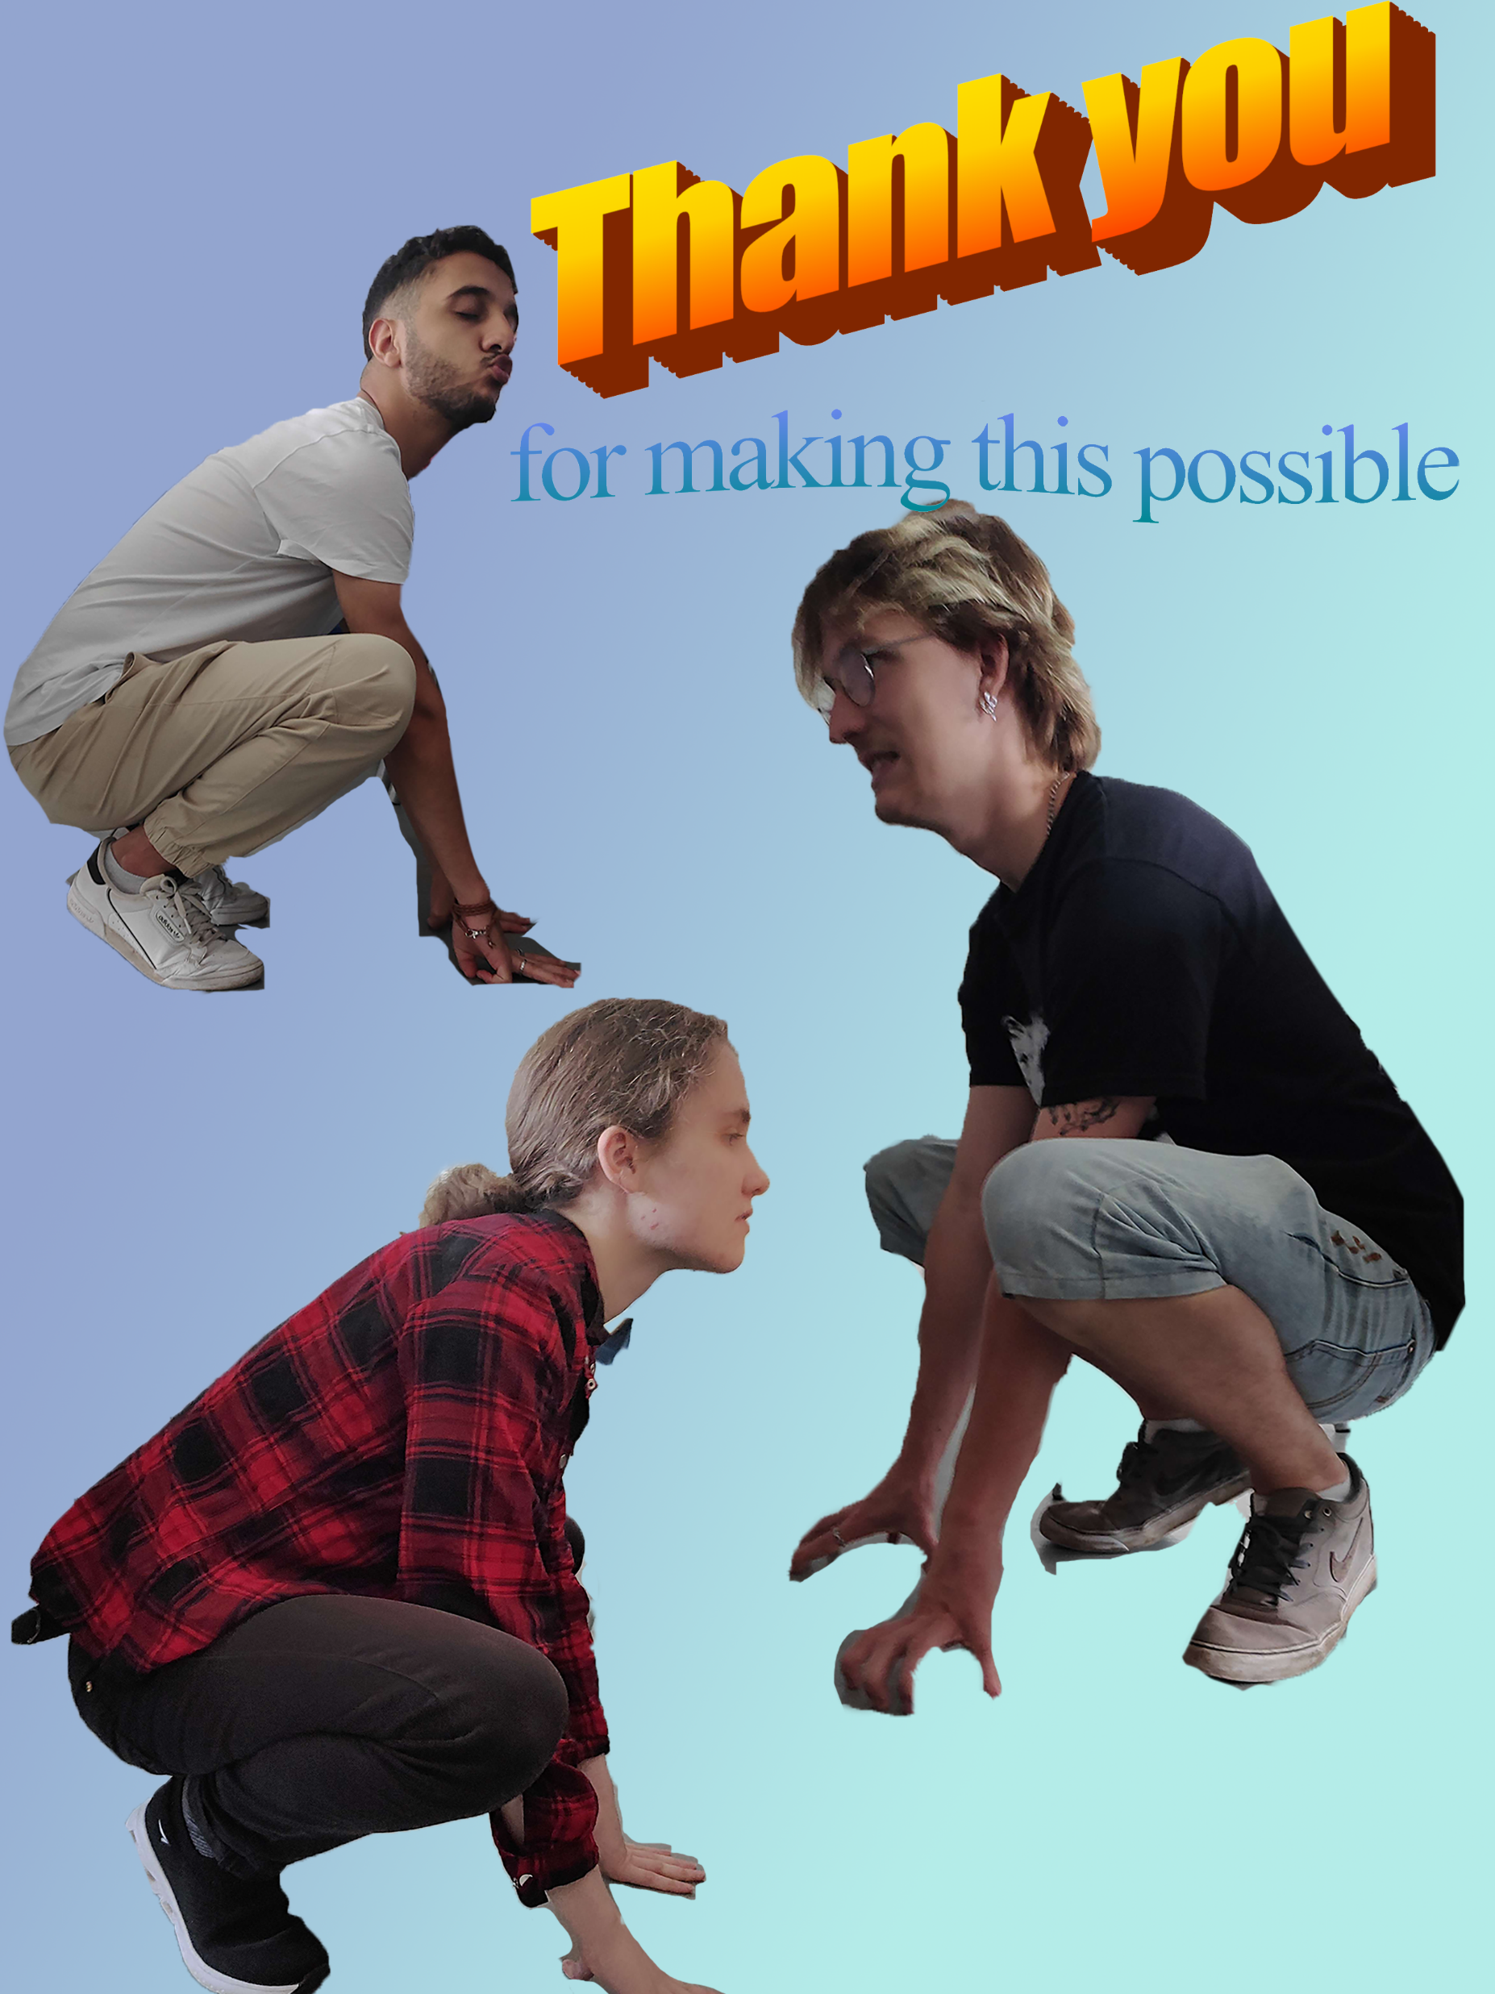
The Angels

Slide 32
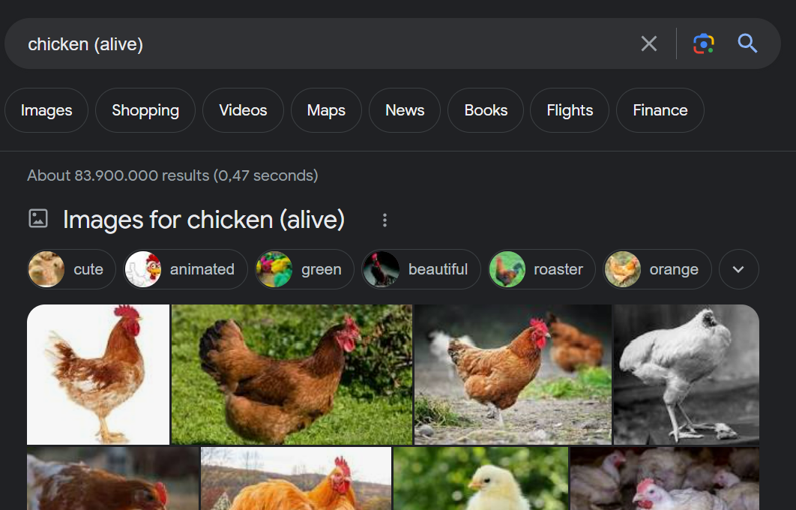
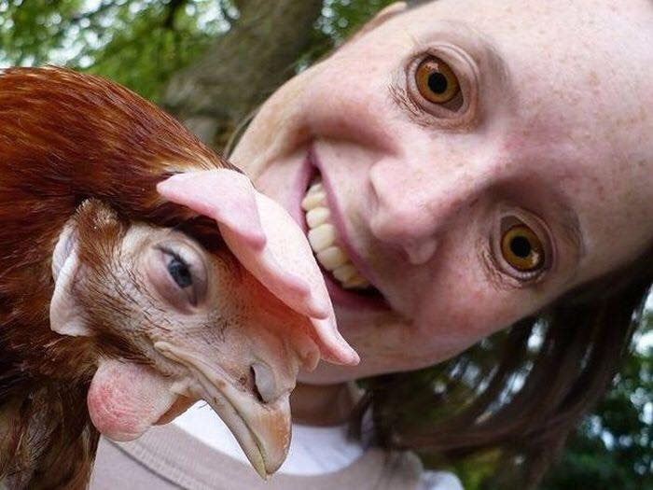
The Kappa

Slide 33
Hendrik Wagner
Has earned his Feierabendbier

Slide 34
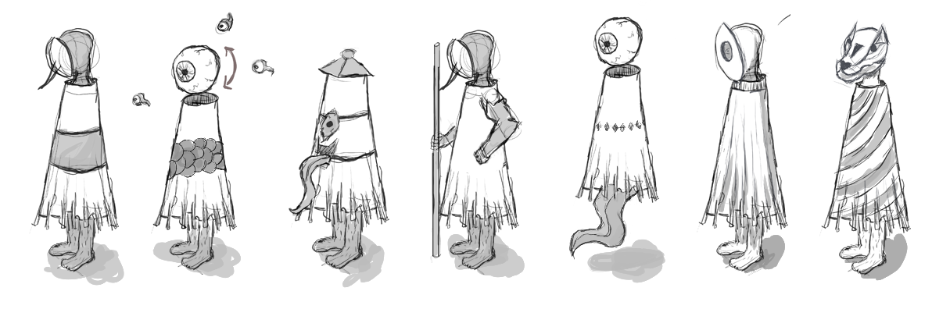
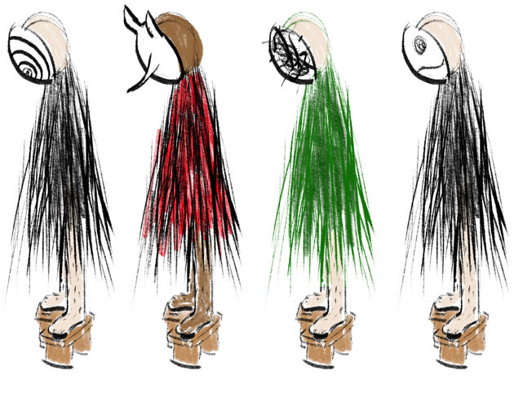
The Kasa Obake

Slide 35

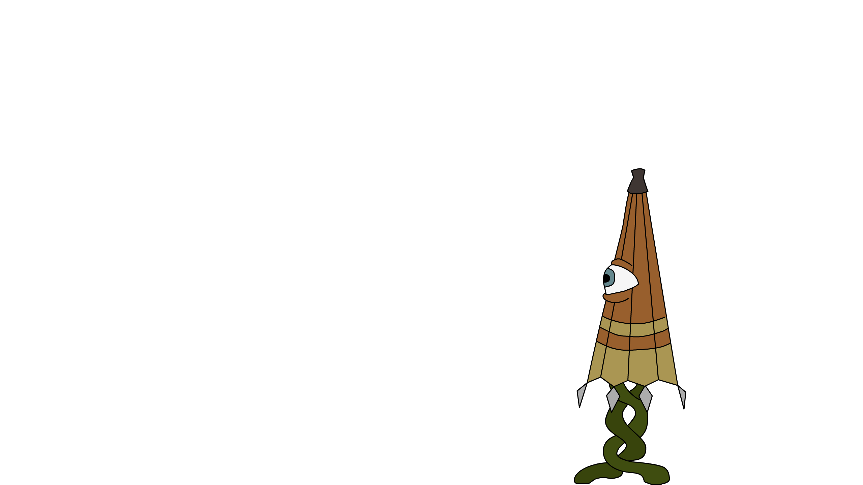
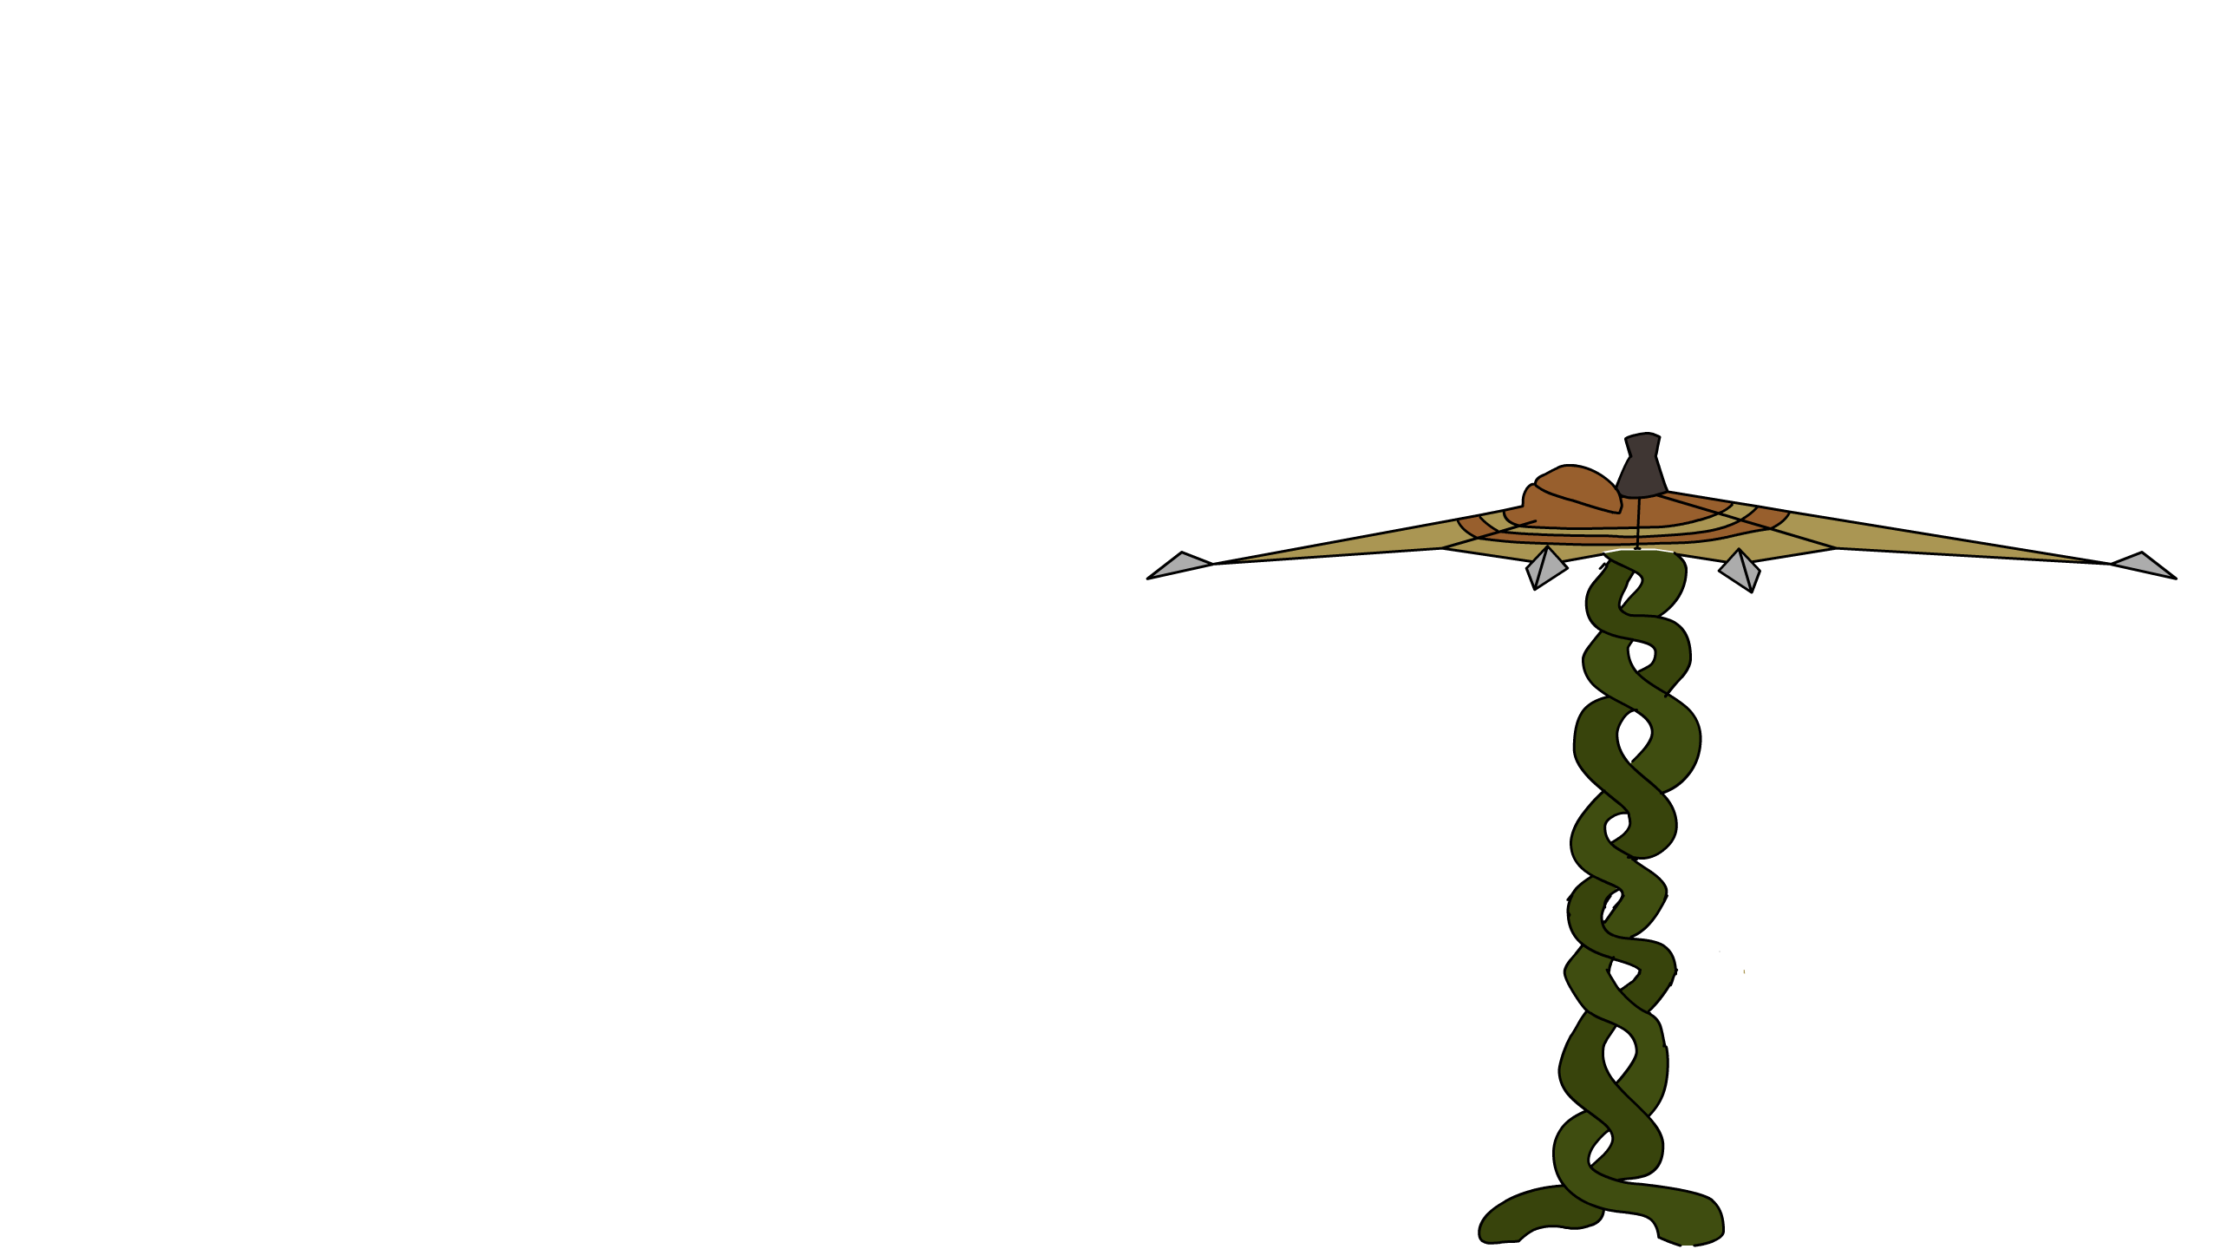
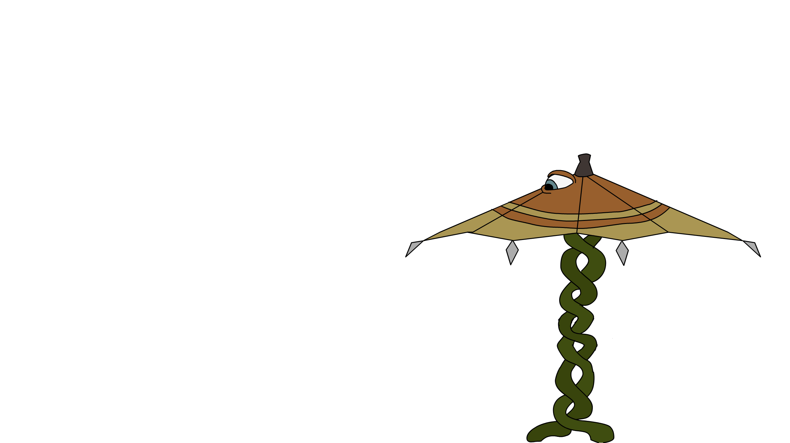
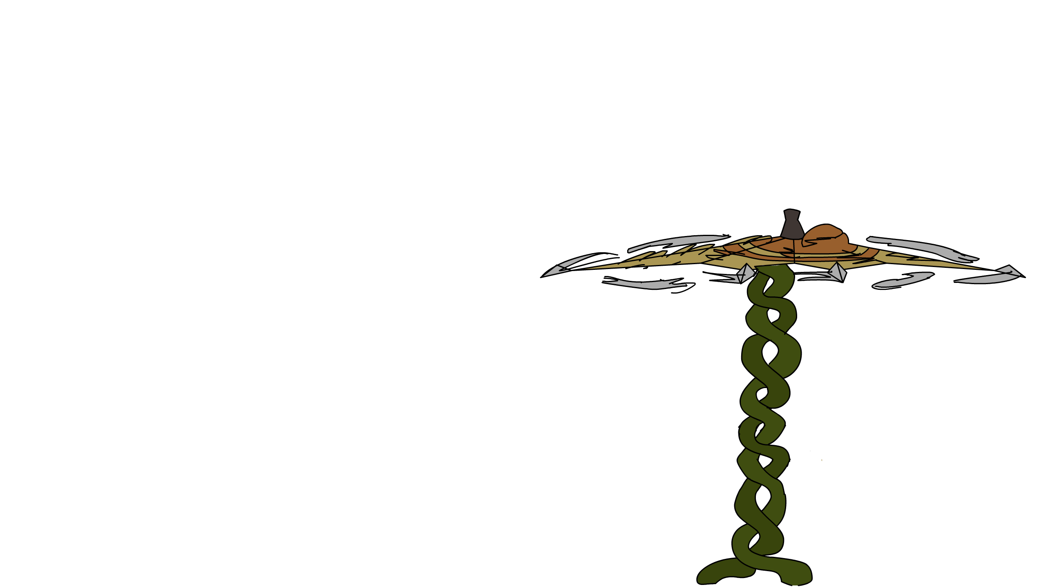
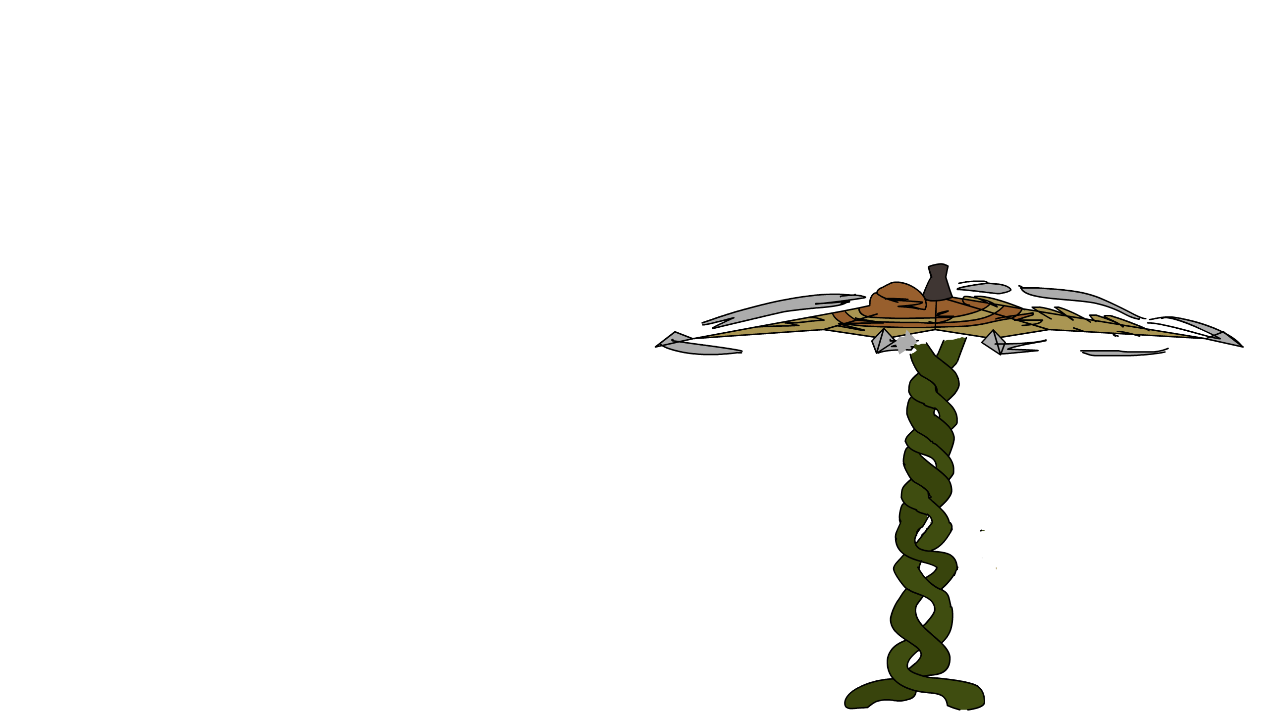
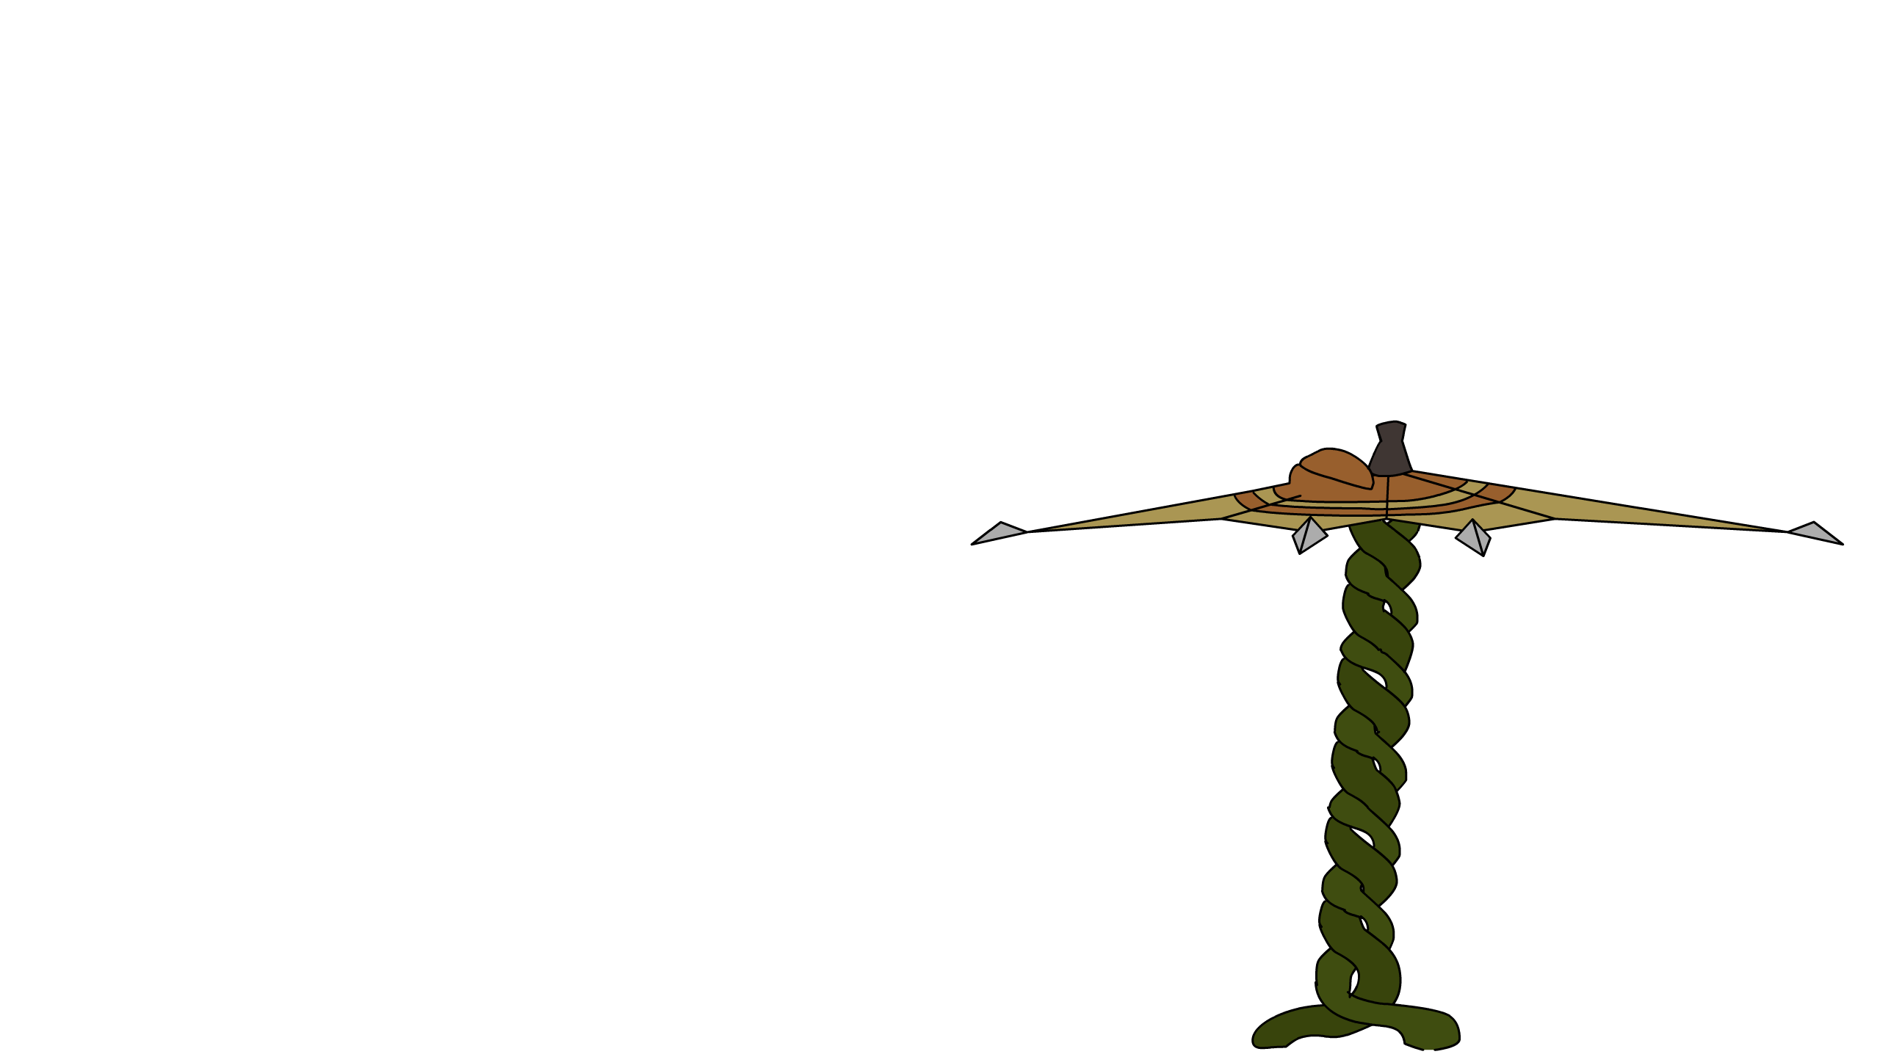
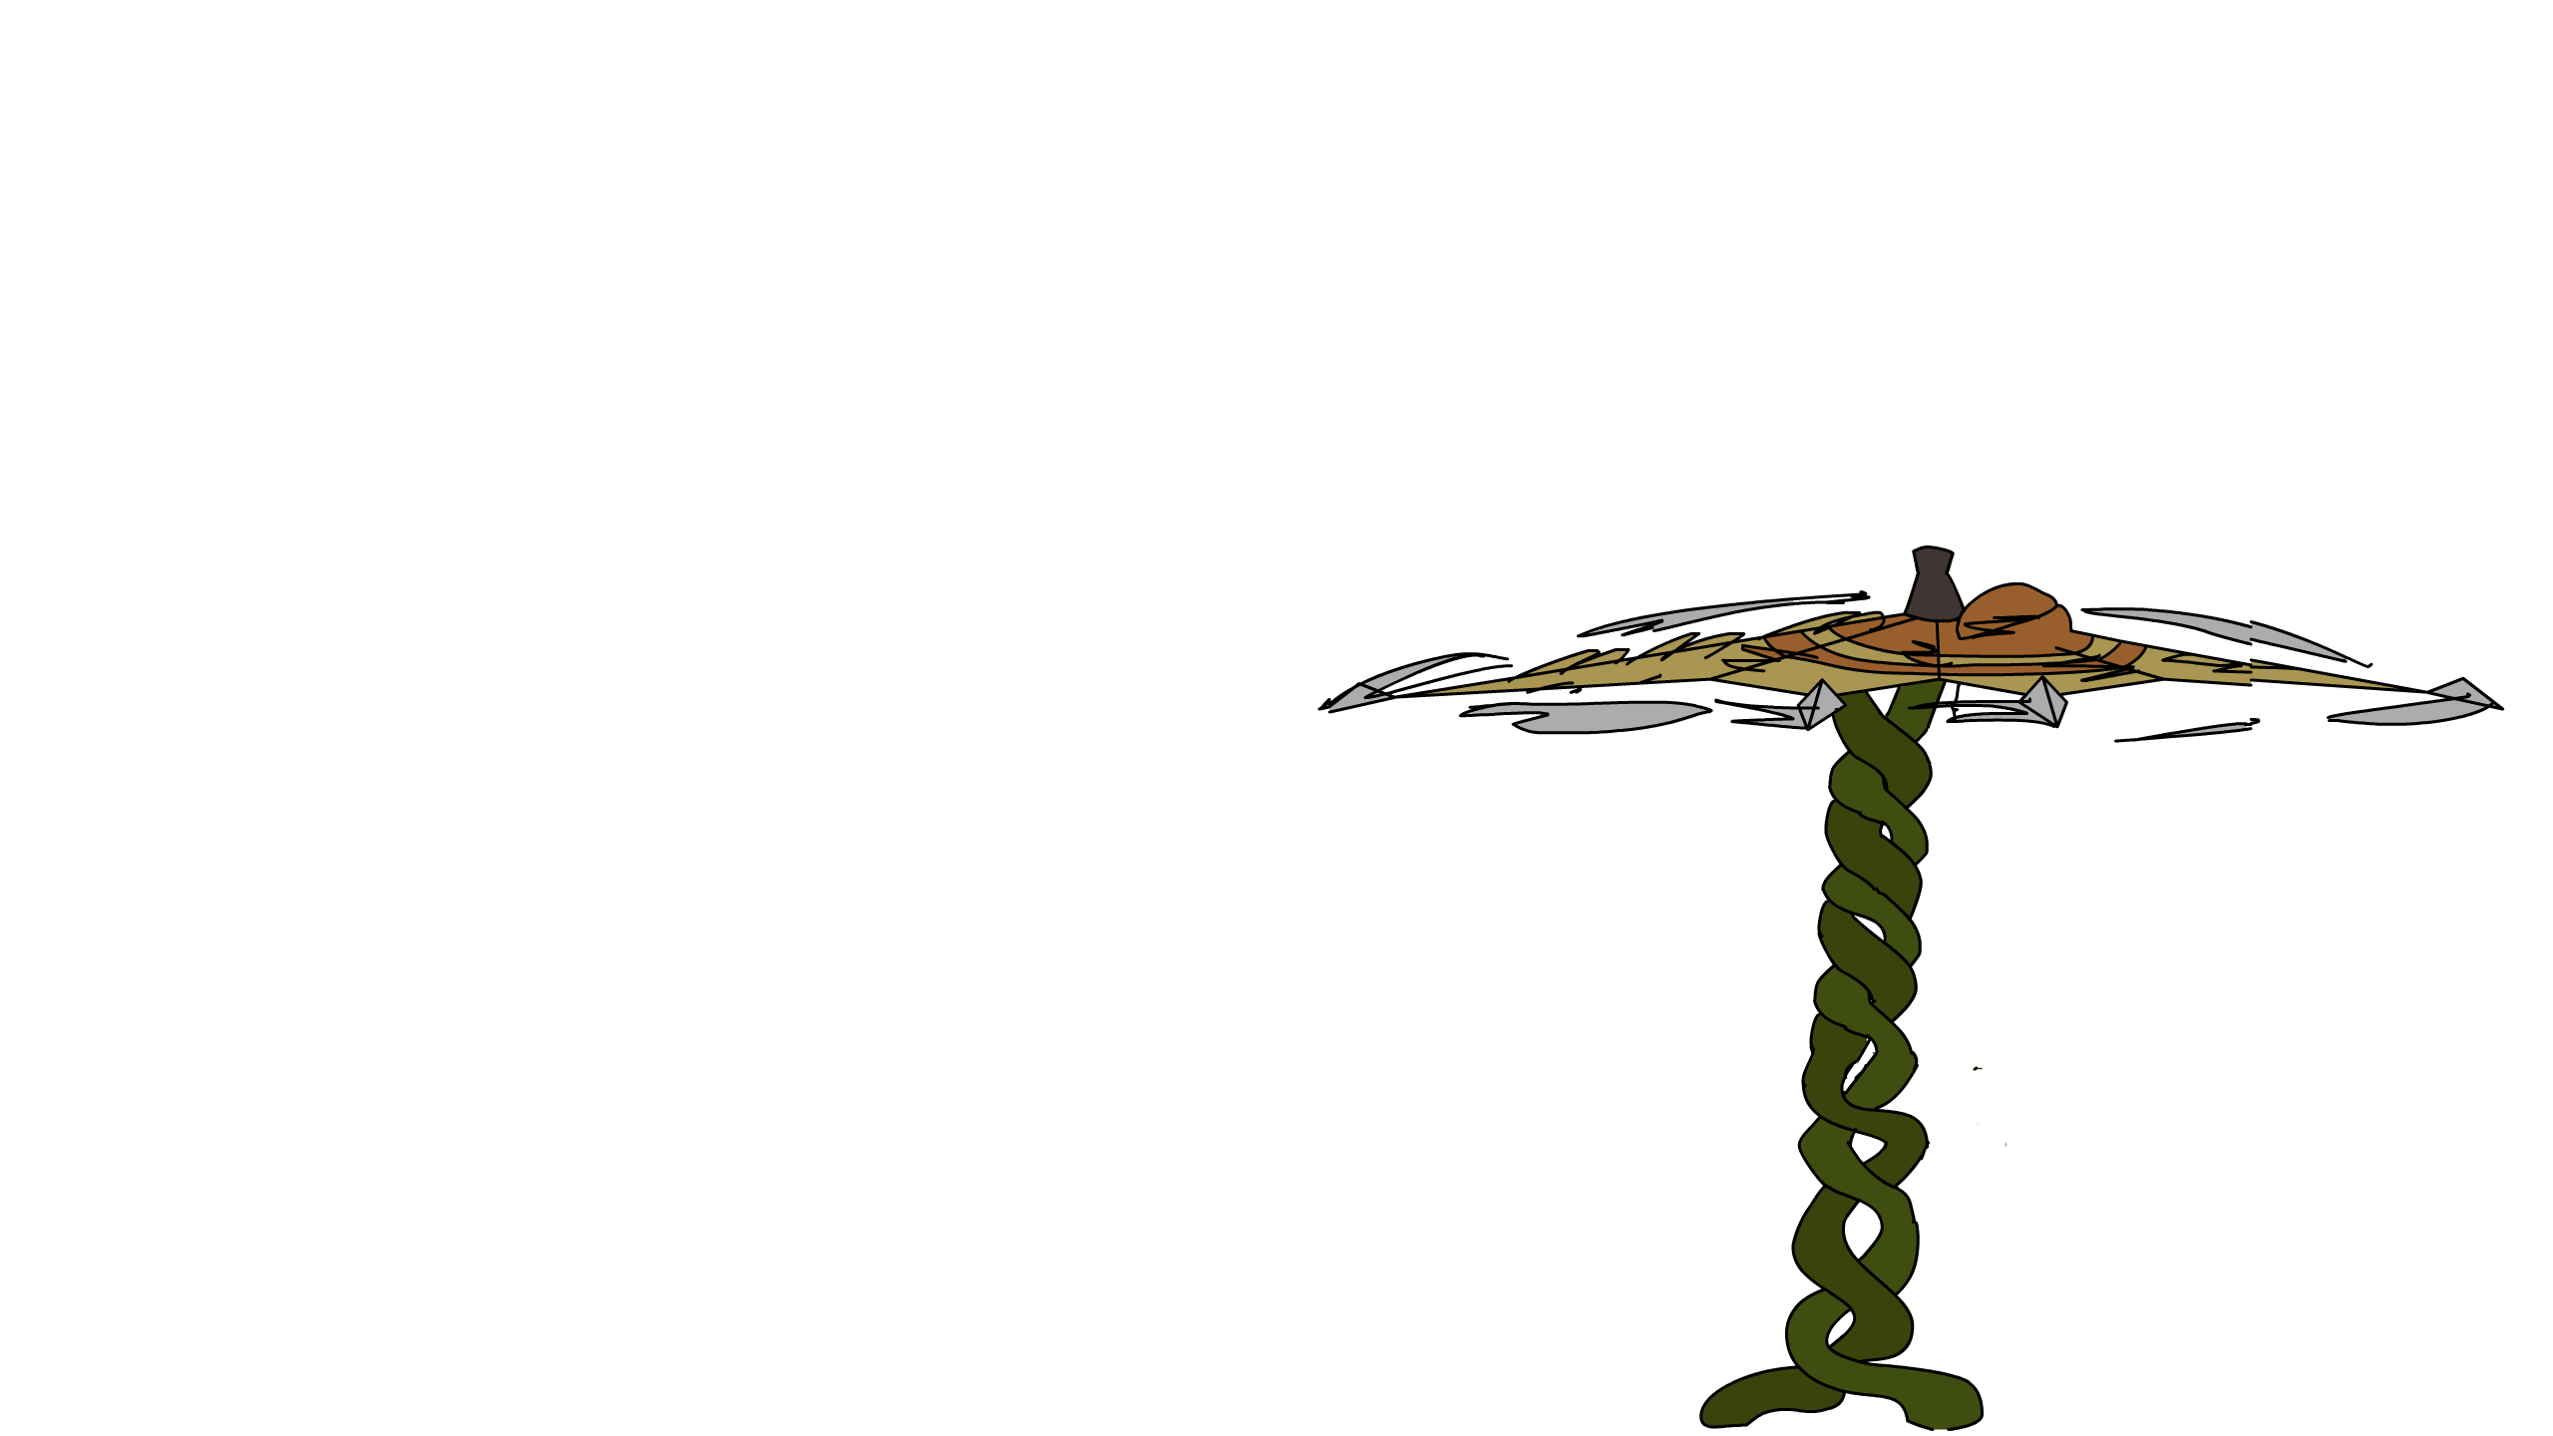
The Kasa Obake

